Slide 1

Big Shoulders Fund | Stock Market Program 2022-2023
Diversification:
Why buy more than one stock?
Class 4 – December 7, 2023
Damian
John

Slide 2

What will we cover in this class?
St. Constance:
November #4
Lesson: Diversification
HW Review + Watch Lists
* source

Slide 3
St. Constance Class Portfolio
On December 7th, the class voted to Sell $100 of Amazon (AMZN) so they could buy $100 of Fisker (FSR)
Do you notice any differences between the Portfolio & Watch List stocks?

Slide 4
St. Constance Watch List
These are the stocks from Homework 1 & 2 that did NOT make the SC Class Portfolio.
We will keep track of these stocks all year! SC has the option to trade the portfolio every month.

Slide 6
Recap of Key Concepts to Date
Stocks are partial ownership in the equity of a publicly traded company.
Historically and over longer time periods, stocks perform better than other places you can invest your money.
Stocks carry risk and investors can lose money in an individual stock if the company struggles.
Stock market can be volatile and there are periods of time when stock prices generally fall and investors lose money.
A company’s profitability is a key measure investors use to evaluate whether they should invest.
  Profit = Revenues – Expenses

Slide 7
Should You Put All Your Eggs in One Basket?
Where would you invest $100 of your own money?
  5 stocks from different industries
  5 stocks from the technology sector
  1 stock about to release a new product
Explain your answer
Notes:
Add to notes activity from Schwab

Slide 8
What if Your Expectations are Wrong?
There is no crystal ball to see into the future to consistently and correctly predict the future.
Top portfolio managers with great research and lots of experience frequently get investment predictions wrong.
How can we reduce the risk, or the downside, of getting things wrong?
Over the long term, great investors are right on average more than they are wrong, and they minimize downside on their mistakes.

Slide 9
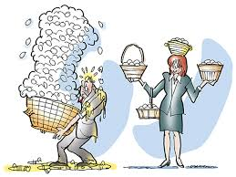
Diversification
What does the phrase “don’t put all your eggs in one basket” mean?
  The risk of losing everything by putting all your hard work into one plan or one course of action
How can we apply this concept to investing?
  Through the use of diversification. This is a key concept in investment portfolios.
  Diversification is the practice of spreading investment dollars among different types of investments to reduce risk.
  In the stock market, diversification means spreading investments across different sectors and/or industries.

Slide 10
Diversification Reduces Risk
Diversification increases the stability of your portfolio and decreases your risk of losing money in the event that a single stock (or asset class, sector, or demographic region) decreases in value.
What does this mean?
  If you invested all of your money into one company’s stock, but you were very wrong about your expectations and it plunged, you’d lose your money.
When invested in multiple stocks, one stock’s decline has less impact on the entire portfolio.
If you were right all the time, you would not want to diversify.
  No one is right all the time.

Slide 11
Benefits of Diversification
Consider two investment portfolios
Portfolio A: $1000 of Disney stock
Portfolio B: $500 of Disney stock, $500 of Coca-Cola stock
DIS falls 25%, but KO is flat
What is the ending portfolio value and % return?
 | Starting portfolio value | Ending portfolio value | Gain/loss and % return
A | $1000 DIS | $750 DIS | Loss -$250 Return -25%
B | $500 DIS $500 KO $1000 total | $375 DIS $500 KO $875 total | Loss - $125 Return -12.5%

Slide 12

Diversification Increases
Investment Choices
Diversification requires you to own a wide variety of investments.
What does this mean? Instead of just owning a single stock, you invest in multiple industries, sectors, regions, and even asset classes.
Highly diversified portfolios carry lower risk, but the more diversified you become, the less differentiated your performance will be vs. the broader market.
Notes:
Lower Maintenance
A wide variety of investments is less risky and typically requires less attention

Slide 13
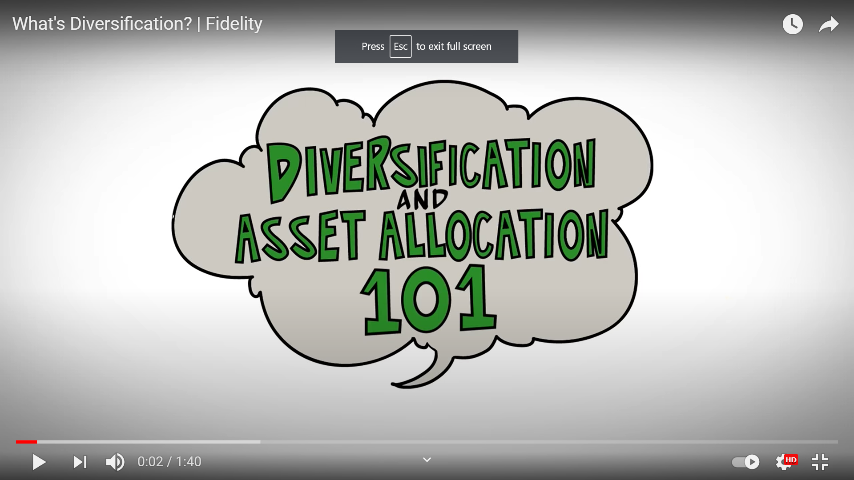
Diversification/Asset Allocation Overview
    https://www.youtube.com/watch?v=LU8tubkz_Fg

Slide 14
Individual Competition:
Sector Fund Edition!
You will be competing against your classmates only.
Each student will choose a different Sector Fund!
In January, each student will give a 1 minute presentation on:
Why they chose their Sector?
Why the Sector will grow the most this semester?
Which stocks (if any) from the Portfolio are in that Sector?
Lastly, which Sector will be the most popular among SC Students?
                Students must hold their Sector from January through the end of the year.
                The students whose Sector has the largest percentage growth will win a prize. If many Students choose the same Winning Sector, those students will split the cash prize! You will have to decide if you want to choose a popular sector (split the prize) OR try to pick something nobody else will.

Slide 15
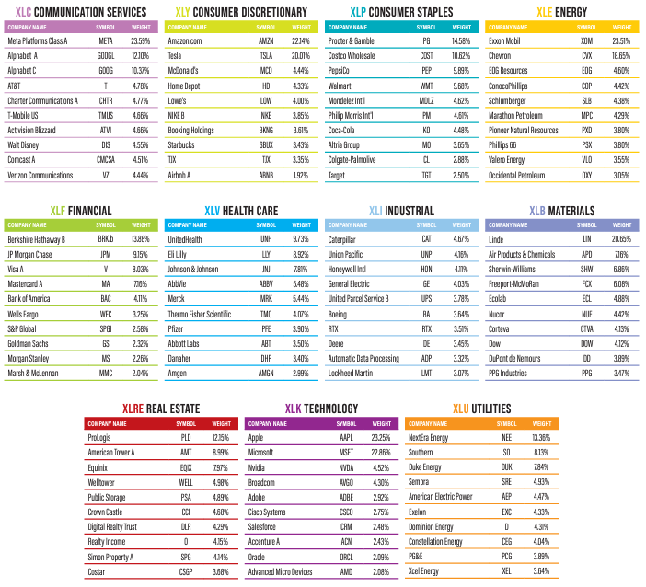
Individual Contest: Sector Funds
This table shows the largest stocks in each sector!
You will recognize many of these names – maybe that will help you figure out which Sector you think will do best before graduation?
Don’t forget – if many students choose the same sector they will have to SPLIT the prize if they win!

Slide 16
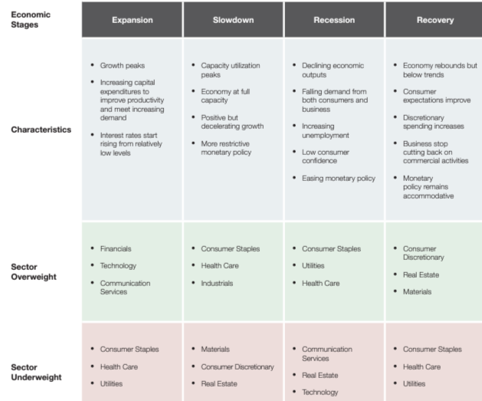
Individual Contest: Sector Funds
Remember the cycles you learned about in the Economic Machine video?
This table shows how sectors follow the phases of the economic cycle.
Sectors are relevant to portfolios and the economy in their own unique way. Because companies are grouped based on their revenues, the companies within a sector portfolio react similarly to changes in the economic backdrop. In addition, sectors vary greatly in their risk profile as a result of the varied nature of each sectors cyclicality. This allows investors to diversify their portfolios in unique ways.

Slide 17
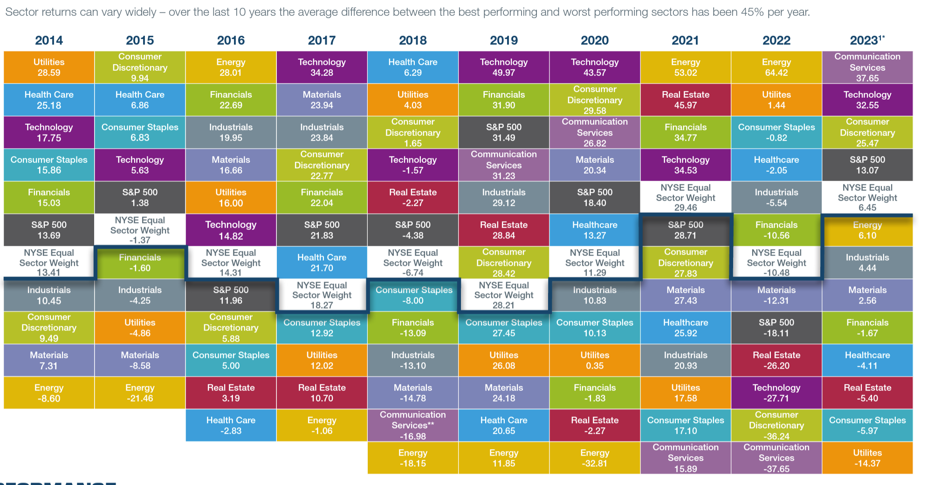
Individual Contest: Sector Funds
Which one of these will do the best between January and April?
Some swing from the top to the bottom. Others tend to stay in the middle.
Which ones do you think are the best for the contest? Portfolio?

Slide 18
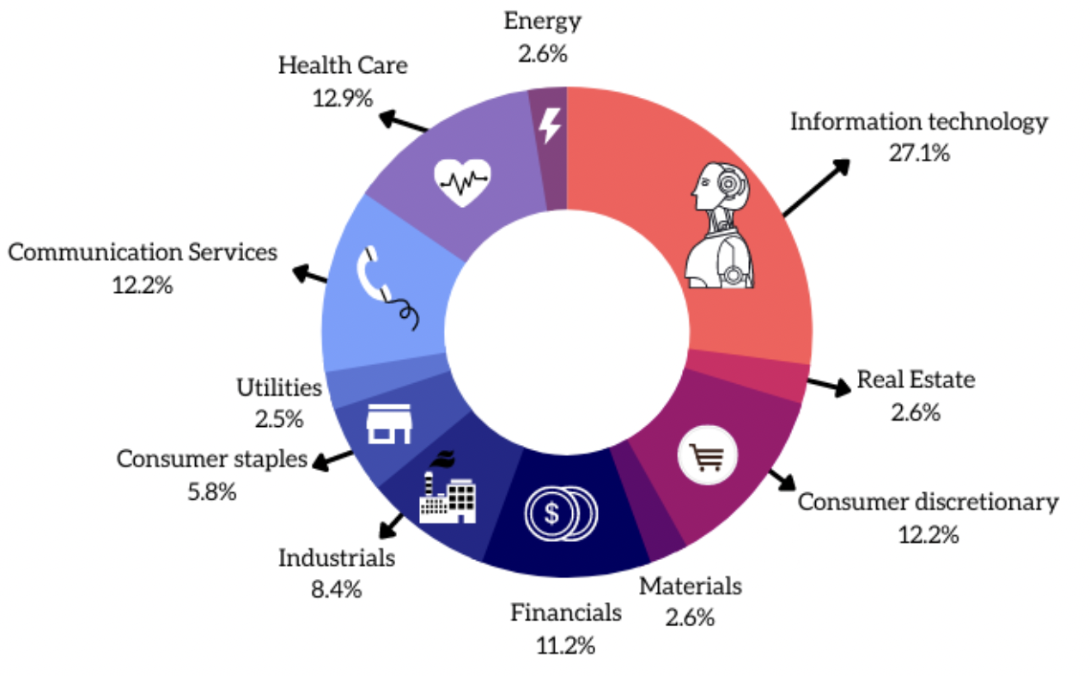
Is Our Class Portfolio Diversified Across Sectors?
Let’s look at our portfolio and see what sectors these stocks come from.
Does our portfolio need to be more or less diversified?
Notes:
Discuss whether this is enough diversification or not.

Slide 19
Optional Homework:
Portfolio Trades
Should we make any trades in our class portfolio next month?
Since we now have 6 stocks in the portfolio, and that is the maximum allowable, we must sell a current stock in order to add anything new.
If you think we should buy a new Stock, please provide three good reasons why that company is better than One or More stocks in the SC Portfolio
Your reasons should not be related to recent stock performance – since the history is behind us and future changes will drive portfolio outcomes
We will discuss your idea with the rest of the class – and then vote

