Slide 1

Big Shoulders Fund: Stock Market Program
St. Constance Class of 2024
Saving and Investing
Class 1 – September 28, 2023
Damian
John
First Activity: Stock Market Art
Only use one side!

Slide 2

What will we cover in this class?
St. Constance
Class of 2024
Lesson: Saving & Investing
Activity: Stock Market Art!
* source:

Slide 3
Questions for the Class
What is the best thing to do with money you saved?
What are the names of your teachers for SMP?
What does it mean to save money?
Who can name two Course topics from the prior slide?
Is saving important?
Who can explain to the class what it means to retire?
Hint: Raise you hand whenever you know the answer to an easy question – or you might be forced to answer a hard question!
* source:

Slide 4
Overview of Main Competition
Big Shoulders Fund 8th grade classes will compete against each other.
St. Constance will be given $3,000 for the 8th grade to invest in
            4 - 6 stocks; Fortune 500 companies; must trade on NASDAQ or NYSE
Competition is based on the class portfolio’s overall performance.
The class will choose stocks in November – and the contest ends in April
At the end of the year your total portfolio will go to St. Constance:
2% management fee of ending portfolio value for each student;
+ Individual winner prize (To Be Determined)
+ Any transportation costs for Big Shoulders Field Trip Downtown
Everything left over will be the 8th grade class gift to the SC
Additional Prizes given to top 3 schools of:
1st Place: $1,000 bonus
2nd Place: $500 bonus
3rd Place: $250 bonus

Slide 5
Overview of Individual Competition
You will be competing against your classmates at St. Constance only.
Each student will choose a different stock. No exceptions!
Each student will give a 1 – 2-minute presentation on:
Why they chose their stock?
Why their stock will grow the fastest?
                Students must hold the SAME stock from January through April
                The student with the largest percentage growth will win a prize!!

Slide 6
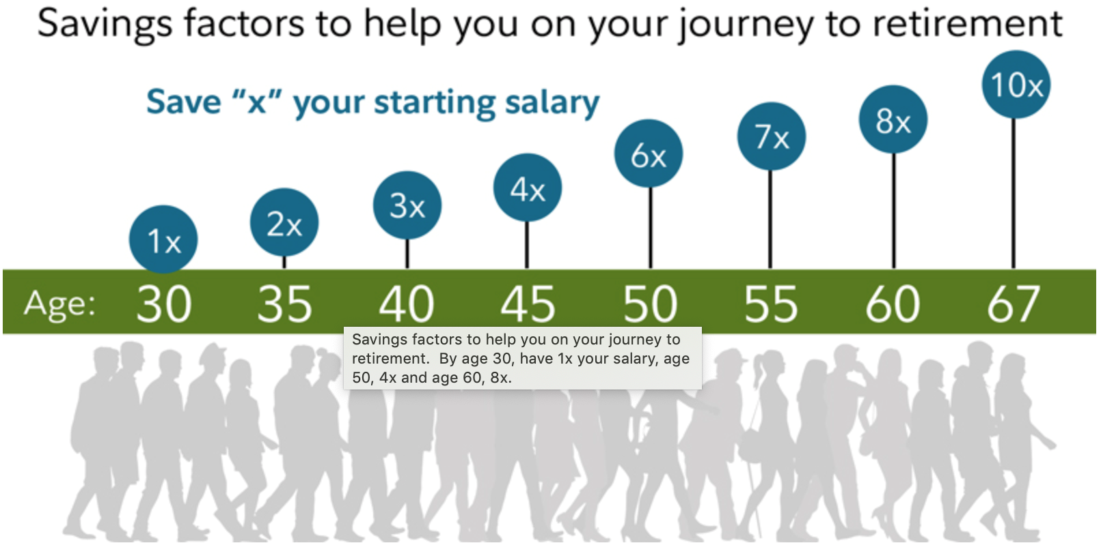
Why Save or Invest?
Retirement
Many people want to stop working as they become older.
This is called retirement.
At age 67, a typical individual should target having 10x their salary saved for retirement, assuming average life expectancy.

Slide 7
Sources of Income in Retirement
Only about 7% of employers offer a new hire a traditional pension today.*
  A pension is money an employer promises to pay their employees after they retire.
In 1935, the federal government started the Social Security Program, which paid retirees an annual income from age 65 onwards.
The amount of Social Security benefits received at retirement depends on:
  number of years worked,
  average salary, and
  when you start receiving benefits.
Social Security was not designed to fully cover a retired person’s expenses.
Unfortunately, many people do not have additional savings and rely on it for their living expenses in retirement.
* source:

Slide 8

How Much Do I Need to Save? An Example
Michelle worked her entire adult life – and retired at age 67.
She averaged a $75,000 salary over her career.
To maintain her standard of living…
Michelle needs at least $61,000 in income after taxes every year.
Her Social Security payments would be $29,800.
This means she must generate $31,200 of income from her retirement accounts.
To be able to do this, she would need $650,000 in savings.
* source:

Slide 9


Other Reasons To Save & Invest
Big Ticket Items & Surprises
If you want to buy a house, you will need to have a down payment saved before you will be approved for a mortgage.
We also save so we can treat ourselves to Wants:
  Vacations; nice dinners out
  a new cell phone; video games, TV
  a nicer car.
Life is filled with expensive surprises, like
  medical bills
  losing a job; or
  needing to replace your water heater.
You should build up savings so that you are able to handle these surprises without having to borrow money, which must be paid back with interest.
What would you like to buy for yourself one day?

Slide 10

Personal Finance:
This 8 Year Old Has It Covered!
2 minutes
Link to YouTube Video – Rapid Fire Financial Literacy
Notes:
https://www.youtube.com/watch?v=4eHBeAJCl8o

Slide 11
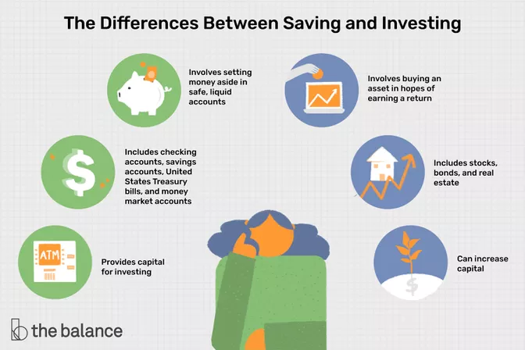
This program will talk about savings and investment

Slide 12
Stocks
Definition: An instrument (share) that provides the holder with partial ownership in a company.
You can buy an individual stock, ex. Apple or a basket of stocks.
Stocks have the highest returns of mainstream investment products.
Over the very long term stocks have returned ~10% per year.
Stock can be bought through brokerage firms like Robin Hood.

Slide 13
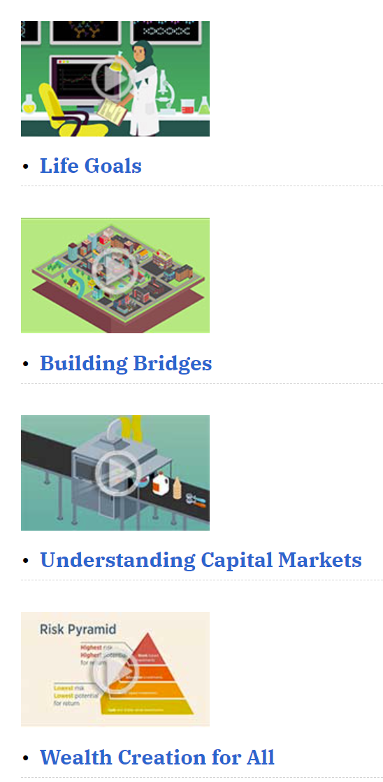
What is a Stock?
This video is helpful for HW – and the other three can be found on the website below
Four Videos supporting the Stock Market Game https://www.stlouisfed.org/education/tools-for-enhancing-the-stock-market-game-invest-it-forward
5 minutes
https://www.stlouisfed.org/education/tools-for-enhancing-the-stock-market-game-invest-it-forward/episode-1-understanding-capital-markets
Notes:
https://www.stlouisfed.org/education/tools-for-enhancing-the-stock-market-game-invest-it-forward/episode-1-understanding-capital-markets

Slide 14
Return Overview
If you invested $50 a month from the time you were 25, until you turn 65, you would have the following amount saved:
Checking account at 2% interest: $36,067
Savings Account at 3% interest: $46,302
Bonds at 4.5% interest: $66,038
Stock Market at 7% return: $121,361
Which would you rather have?
Why?

Slide 15
The Power of Compounding
Compounding occurs when your investment earnings are added to your principal, forming a larger base on which future earnings may accumulate – an investment turbocharger!
For example, if you invested $10,000 earning 8% annually and reinvested all of your earnings, you would have $21,589 in your account after 10 years.
$10,000 x (1+.08)¹⁰ = $21,589
If instead of reinvesting, you withdrew your earnings each year, you would have collected $800 a year, or $8,000 over the 10 years. The $3,589 difference is the benefit of 10 years of compound growth.
Compounding helps ensure long term investment returns outpace inflation, allowing your purchasing power to grow.

Slide 16
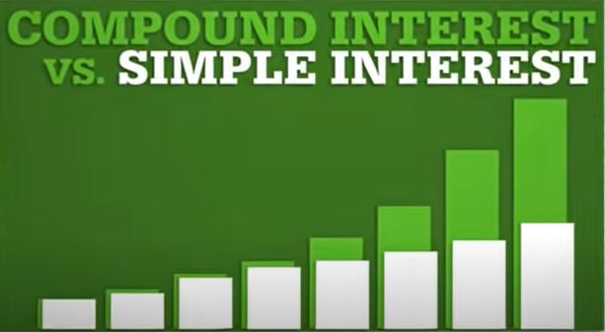
The Power of Compounding
2 minutes
https://www.youtube.com/watch?v=wf91rEGw88Q

Slide 17
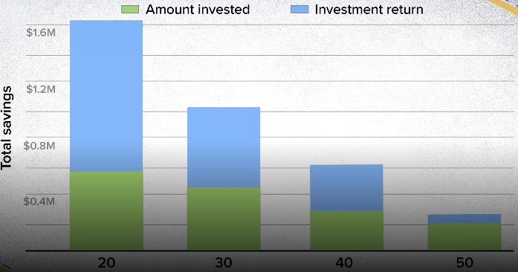
Compounding Rewards Earlier Savers!
2 minutes
Click here for video from CNBC.com
Notes:
https://www.cnbc.com/2020/08/28/how-to-retire-a-millionaire-by-investing-in-the-stock-market.html?&qsearchterm=how%20much%20money%20would%20you%20have%20if%20you%20invested%20$1,000

Slide 18
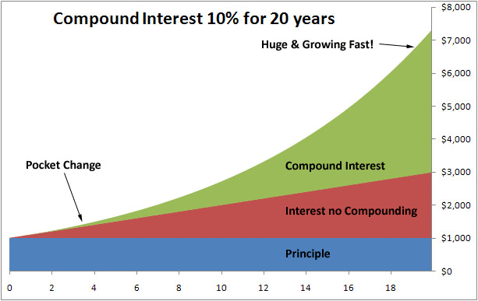
The Power of Compounding

Slide 19
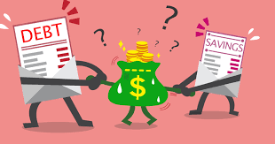
Debt is the opposite of Saving
Debt is what someone owes to someone else. Usually, debt is in the form of money, but it can also be items, services, favors, or other things.
If you make an agreement to give or do something for someone else, you now owe a debt.

Slide 20
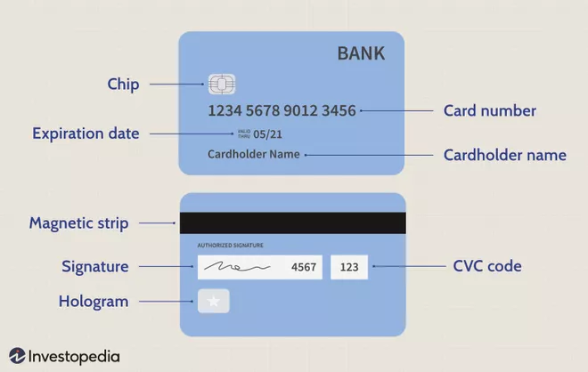
Credit Cards
A credit card is a payment card issued to users to enable the cardholder to pay a merchant for goods and services.

Slide 21
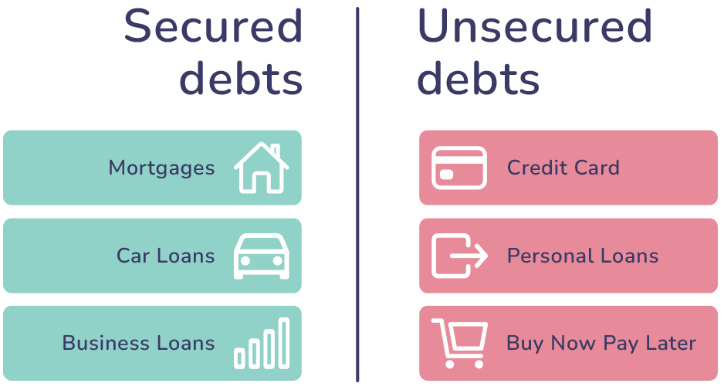
And other versions of debt
(Borrowing Money)

Slide 22
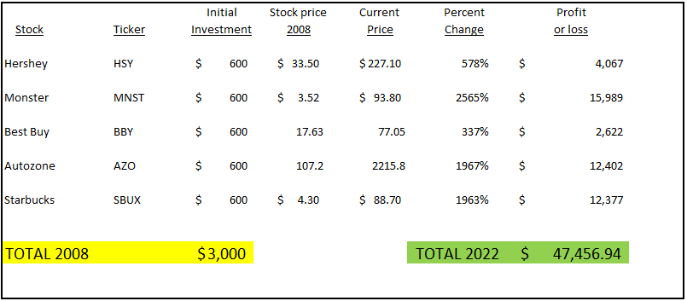
Rate of Return in the Real World
2008 SMP Portfolio @ St. Pius

Slide 23
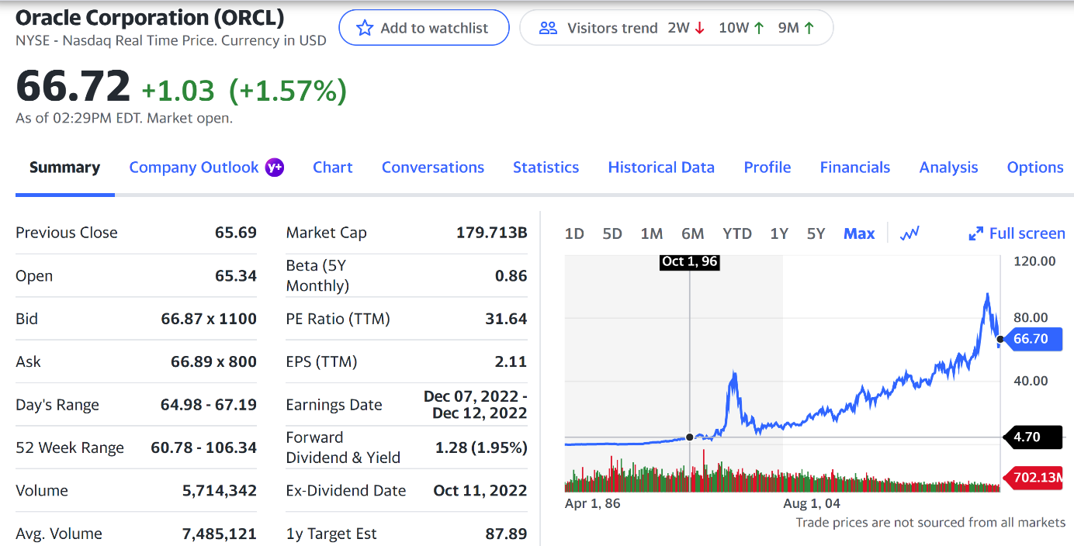
Homework
Think of products or services you and your family use or places you go or things you do. Find out what company makes/owns the product or service.
See if the company is traded on the NASDAQ or NYC.
If not… find another company!
Once you have a company, research pull together a Research Report:
  Ticker symbol + Current price + What does the company do?
  Why you want to invest/purchase this stock? 3 bullet points required

Slide 24
Research Ideas
Watch List
SC Portfolio
The Path Forward
Class # 1 Homework
Class # 2 Activity + HW
Class # 3 Activity

Slide 25
Question for the Class
What
Did
You
Learn
Today
?
* source:

