Slide 1

Big Shoulders Fund
Stock Market Program 2022-2023
Saving and Investing
Class 2 – October 23, 2023
Damian
John
Activity: Drawing the Stock Market

Slide 2

What will we cover in this class?
St. Constance:
October #2
Activity: Draw the Market!
Lesson: Stocks
HW Review + Watch Lists
* source:

Slide 3
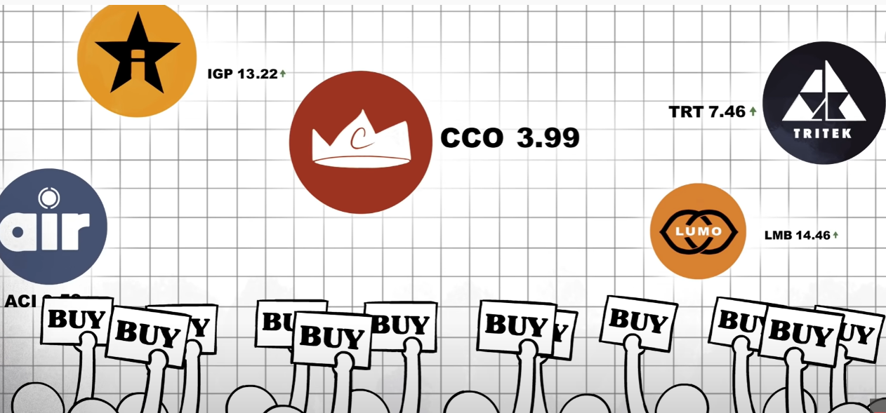
Video Overview of Stock Market
https://www.youtube.com/watch?v=p7HKvqRI_Bo
Notes:
Tip: Have students explore the linked McDonald’s website and ask their thoughts.

Slide 4
Lightning Round Recap:
First Class & TED Video
Q1
What are assets?
Q2
What are liabilities?
Q3
Why save?
Q4
What does risk mean?
Q5
Why invest?

Slide 5

What is a Stock?
Stock Definition
A stock, also called a share, is a security that indicates equity ownership in a company.
If you own a stock, you are a partial owner, and share ownership with thousands or perhaps millions of other stockholders.
Disney has roughly 2 billion shares outstanding and is owned by millions of investors.

Slide 6
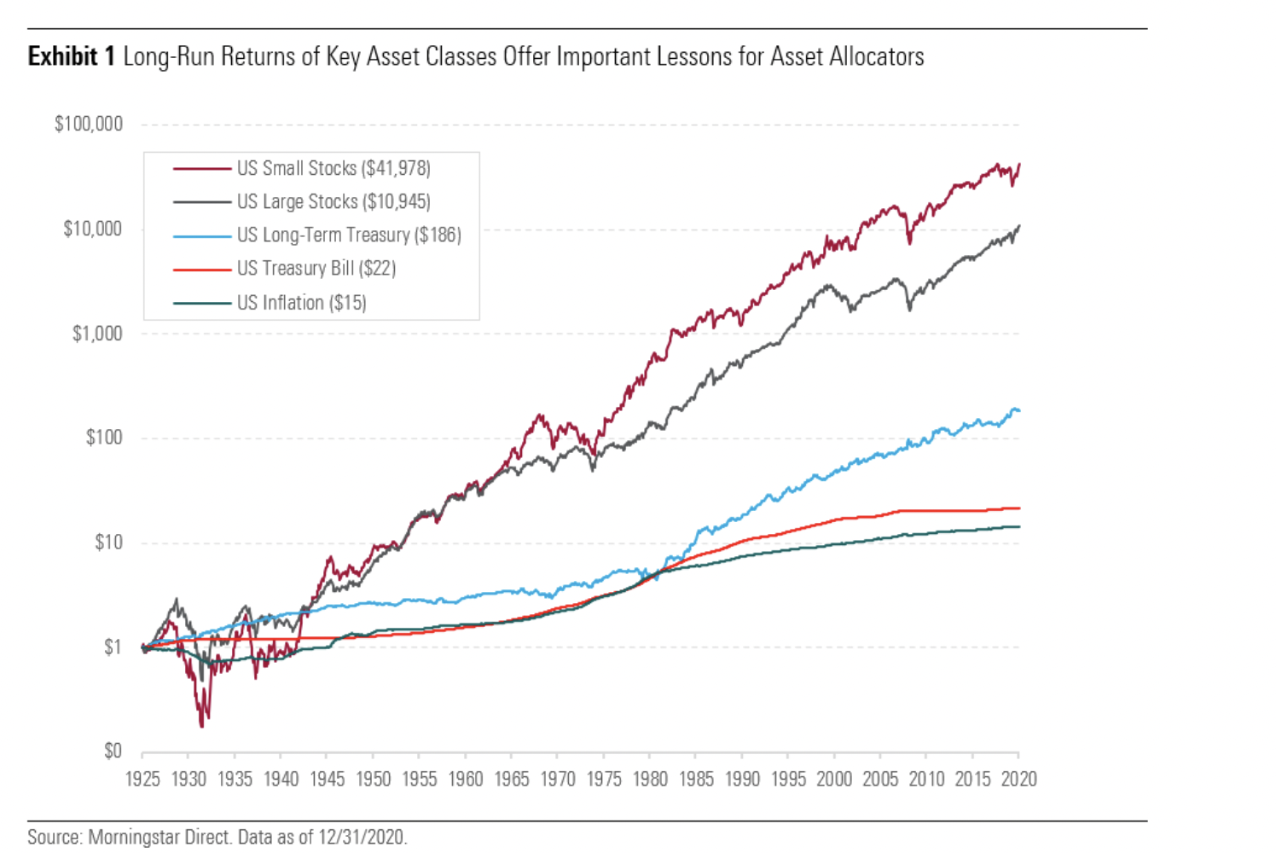
Why Own Stock?
Compared to other savings and investment opportunities (called asset classes), equity ownership can provide a greater return over time.
The longer time horizon you have, the greater the difference between total returns of different asset classes due to compounding of returns.
Sources: 2020 SBBI Yearbook

Slide 7
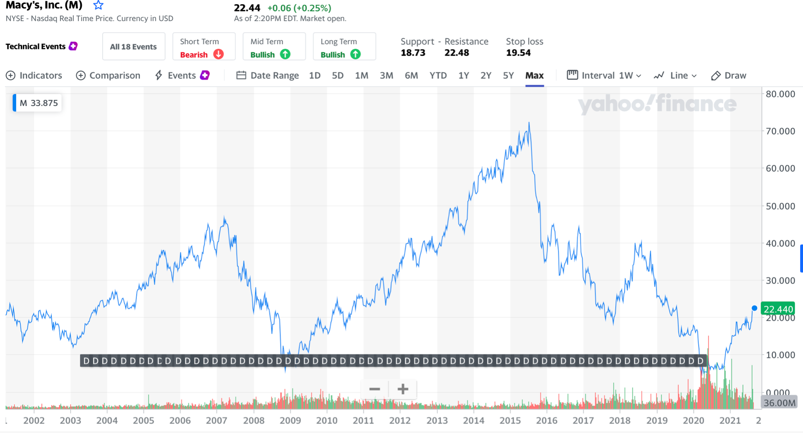
What Can Go Wrong?
Buying stock has potential rewards, but also risks like loss of value:
  Overall economic conditions can hurt a company’s results.
  Bad decisions or competition.
  This can cause the price to drop or even go to zero.
  Why do you think Macy’s stock has struggled?

Slide 8
The Stock Market
The stock market is where shares of stocks are bought and sold. Most stock market trading is actually done using computers.
The market serves two purposes:
    corporations raise money by issuing new shares; and,
    investors can trade existing stock.
The stock market is organized by listing stocks on an “exchange”.
There are 2 major US exchanges:
    NYSE: New York Stock Exchange
    NASDAQ: National Association of Securities Dealers Automated Quotations

Slide 9
The Stock Market
You cannot just buy or sell stock directly on the exchanges.
You must buy/sell stocks using an intermediary such as (with examples):
  Traditional Brokerage Firms: Merrill Lynch, JP Morgan
  On-line Brokerage firms: Charles Schwab, Robin Hood, Fidelity
  Buying a product managed by an Investment Management Company: Ariel Investments, JP Morgan, Janus Henderson

Slide 10
How to Invest in Stocks
Select and buy individual stocks such as Disney, McDonalds, or Apple.
  You do all the work choosing the stocks and monitoring their performance.
Select mutual funds or ETFs, which are a basket of stocks sold in one bundle to you.
  An investment professional or computer picks the stocks for you.

Slide 11
How to Choose a Stock
The company should be successful.
The company should have a product or service that someone wants to purchase.
The company should possess a unique capability or resource that its competitors do not have or cannot easily reproduce.
The company should be profitable, i.e. make money. If the company isn’t making any money now, you need to believe that will change in the future!

Slide 12
How Do We Evaluate Companies?
 | Revenues
- | Expenses
= | Profits

Slide 13
Revenue
Revenue (also called Sales) is the money a company receives when it provides a service or good to a customer.
Example:
  Think of a McDonald’s. The money a person pays to buy a Big Mac Extra Value Meal is considered Revenue for that McDonald’s.
How do we calculate revenue?
  Units x Price = Revenue
How much revenue would McDonald’s collect each day if 200 customers each buy a $6.00 Big Mac Extra Value Meal?

Slide 14
Expenses
Expenses are the costs a company incurs in producing the goods and services they sell.
What kinds of things might go into expenses?
  Materials
      Cost of the Big Mac: Meat, cheese, toppings, bread.
      Cost of the fries, drink and packaging for the food.
  Labor costs
      The cost of paying the cooks, servers and cashiers.
  Overhead
      Rent, utilities, and other expenses a business must incur simply to open for business each day.

Slide 15

Expenses
Example – What are the materials and labor expenses McDonald’s spends to make those 200 meals for customers?
  Materials
    The material cost for each of the 200 meals is $2.00 per meal.
    How much does McDonald’s spend each day on materials?
  Labor costs
    The McDonald’s has 6 employees that work 8 hours each day, and each employee is paid $10.00 per hour of work.
    How much does McDonald’s spend each day to produce and serve the meal?
  Overhead
    It costs the McDonald’s $100 a day in rent and utilities.
What are the total expenses McDonald’s spends to make the meals for customers?

Slide 16
Net Profit/Income/Earnings
Profits (sometimes called net income or earnings) is the money a company has after accounting for all the expenses incurred.
Remember:
Based on our prior simple example for McDonald’s, how much profit did this store realize each day?
Equity holders own a piece of the profits as an investor in the company.
  Their proportional share of the profits is equal the proportion of the company they own.
 | Revenues
- | Expenses
= | Profits

Slide 17

Where Do You Find Information on Stocks
Lots of Free Resources on the Internet
    Yahoo Finance https://finance.yahoo.com/
        Google Finance https://www.google.com/finance/
    Newspapers
  Crain’s Chicago Business
  Wall Street Journal
  New York Times
Research Reports
  S&P Reports
  Brokerage Firms Resources

Slide 18
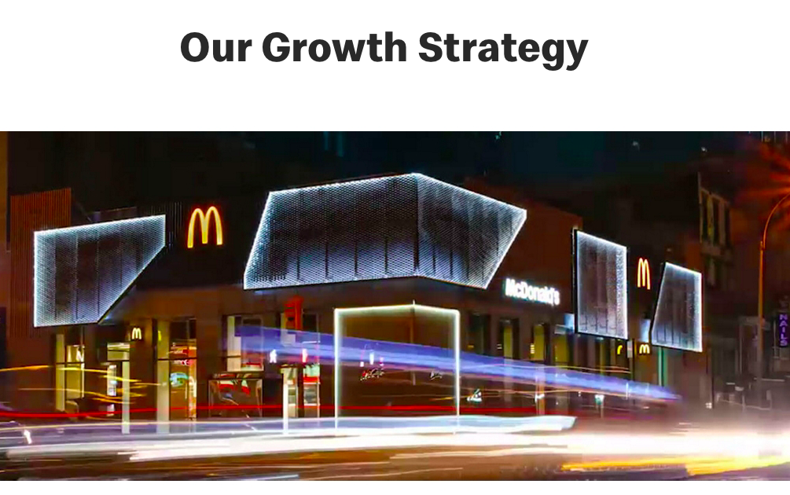
Where Do You Find Information on Stocks
Most, if not all, publicly traded companies maintain an Investor Relations Section of their website, where you can find all sorts of information:
    Press Releases
  Quarterly Earnings and Annual Reports
  Presentations to the Financial Community
  Strategic Plans
Here is a link to the McDonalds Investor Relations Website
Notes:
Tip: Have students explore the linked McDonald’s website and ask their thoughts.

Slide 19
Overview of Main Competition
Big Shoulders Fund 8th grade classes will compete against each other.
Students will be given $3,000 to invest in
            4 – 6 stocks;
        Domestic Fortune 500 companies
        Trade on NASDAQ or NYSE.
Competition is based on the class portfolio’s performance.
Competition will run from
Friday, November 18, 2022, through Friday, April 28, 2023.
At the end of the year your seed money will go to your school, to pay for
2% management fee of ending portfolio value for each student;
Individual winner prize
Any transportation costs
Everything left over will be the 8th grade class’ gift to the school.
Additional Prizes given to top 3 schools of:
1st - $1,000
2nd - $500
3rd - $250 respectively.

Slide 20
Overview of Individual Competition
You will be competing against your classmates only.
Each student will choose a different stock. No exceptions!
Each student will give a 1 – 2 minute presentation on:
Why they chose their stock?
Why the stock will grow the most this semester?
                Students must hold their stock from Friday, January 27, 2023, until Friday, April 28, 2023.
                The students whose stock has the largest percentage growth will win a prize.

Slide 21
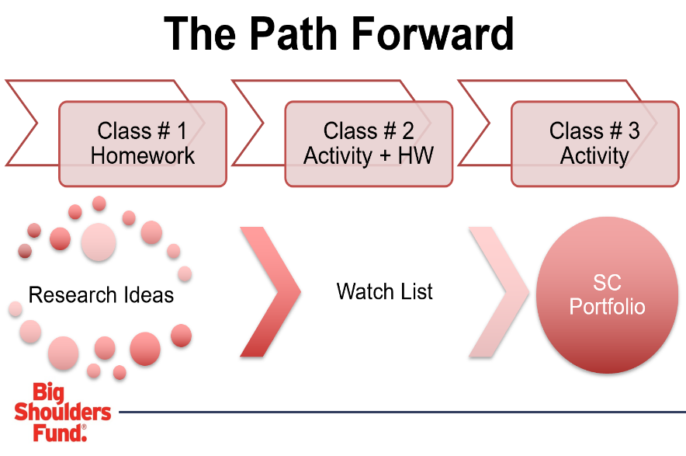
HW Review

Slide 22
Saint Constance Watch List
Class of 2024

Slide 23
Homework #2: Deep Dive on Another Stock from the Watch List
Research One New Stock
Cannot be your stock!
Pick someone else’s stock that you think is interesting and carry out research to figure out if it is a good stock to Buy!
Evaluate price history for that stock (52-week high, 52-week low, and 5-year chart)
Compare Price/Equity ratios to similar companies
Find recent articles or videos on that stock
Make Your Recommendation!
Should we Buy this stock?
YES or NO?!
Deep Dive

Slide 24
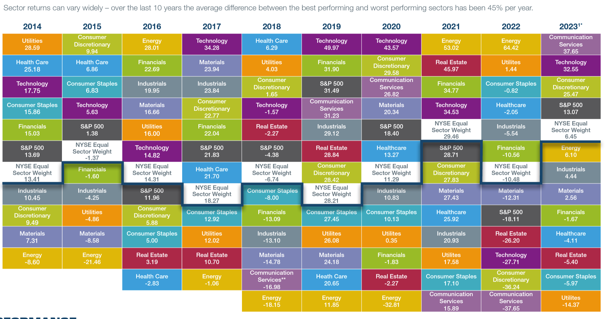
Individual Contest: Sector Funds

Slide 25
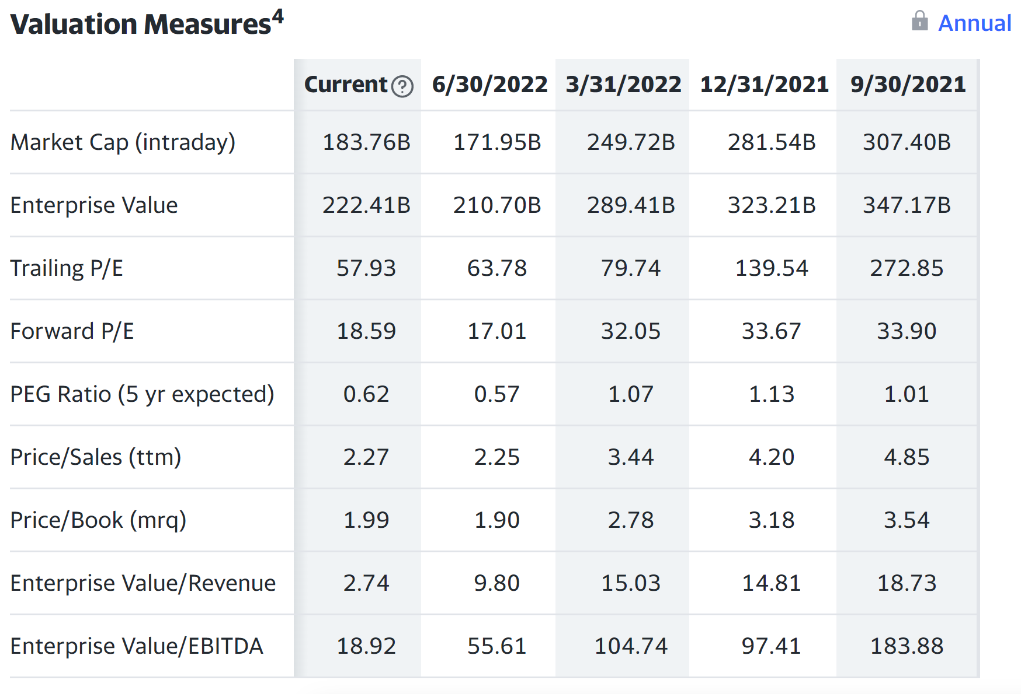
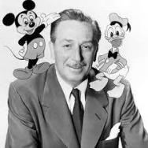
Extra Credit: Find the 3 starred metrics for the stock you are researching!
Disney
DIS
10/7/2022

Slide 26
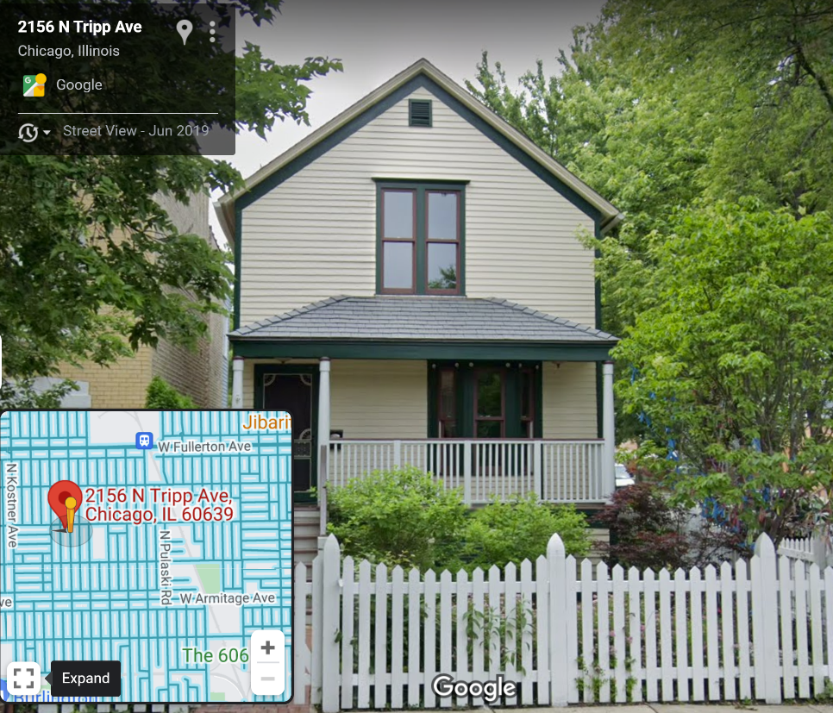
Walt Disney grew up in this house –
5 miles away from Saint Constance!

