Slide 1

Big Shoulders Fund
Stock Market Program 2022-2023
Class Portfolio Discussion
Class 3 – November 13, 2023
Damian
John
Third Activity: Selecting Stocks

Slide 2

What will we cover in this class?
St. Constance:
November #3
Lesson: Stocks
HW Review + Watch Lists
* source:

Slide 3
Overview of Main Competition
Big Shoulders Fund 8th grade classes will compete against each other.
St. Constance will be given $3,000 for the 8th grade to invest in
            4 - 6 stocks; Fortune 500 companies; must trade on NASDAQ or NYSE
Competition is based on the class portfolio’s overall performance.
The class will choose stocks in November – and the contest ends in April
Portfolio Start Date: Friday, November 17, 2023
At the end of the year your total portfolio will go to St. Constance:
2% management fee of ending portfolio value for each student;
+ Individual winner prize (To Be Determined)
+ Any transportation costs for Big Shoulders Field Trip Downtown
Everything left over will be the 8th grade class gift to the SC
Additional Prizes given to top 3 schools of:
1st Place: $1,000 bonus
2nd Place: $500 bonus
3rd Place: $250 bonus

Slide 4
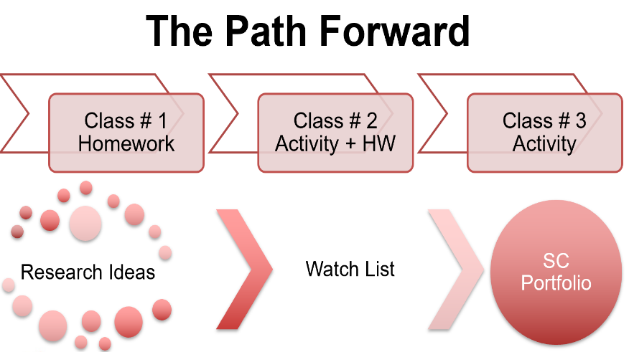

Slide 5
SC Watch List: HW2 Review

Slide 6
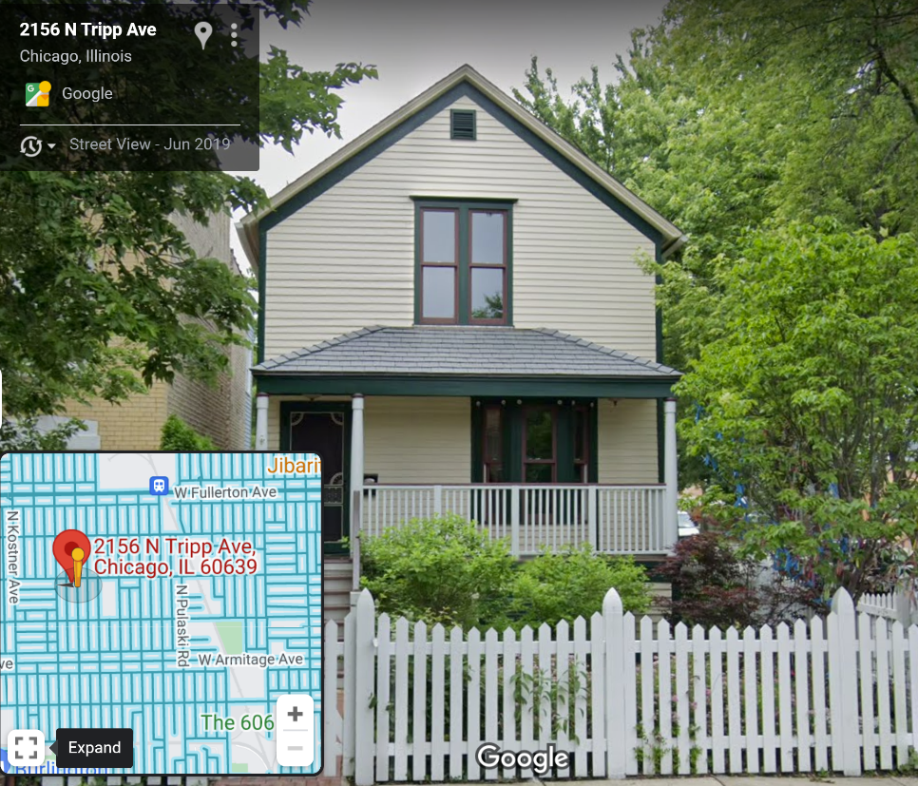
Does anyone know what this is?

Slide 7
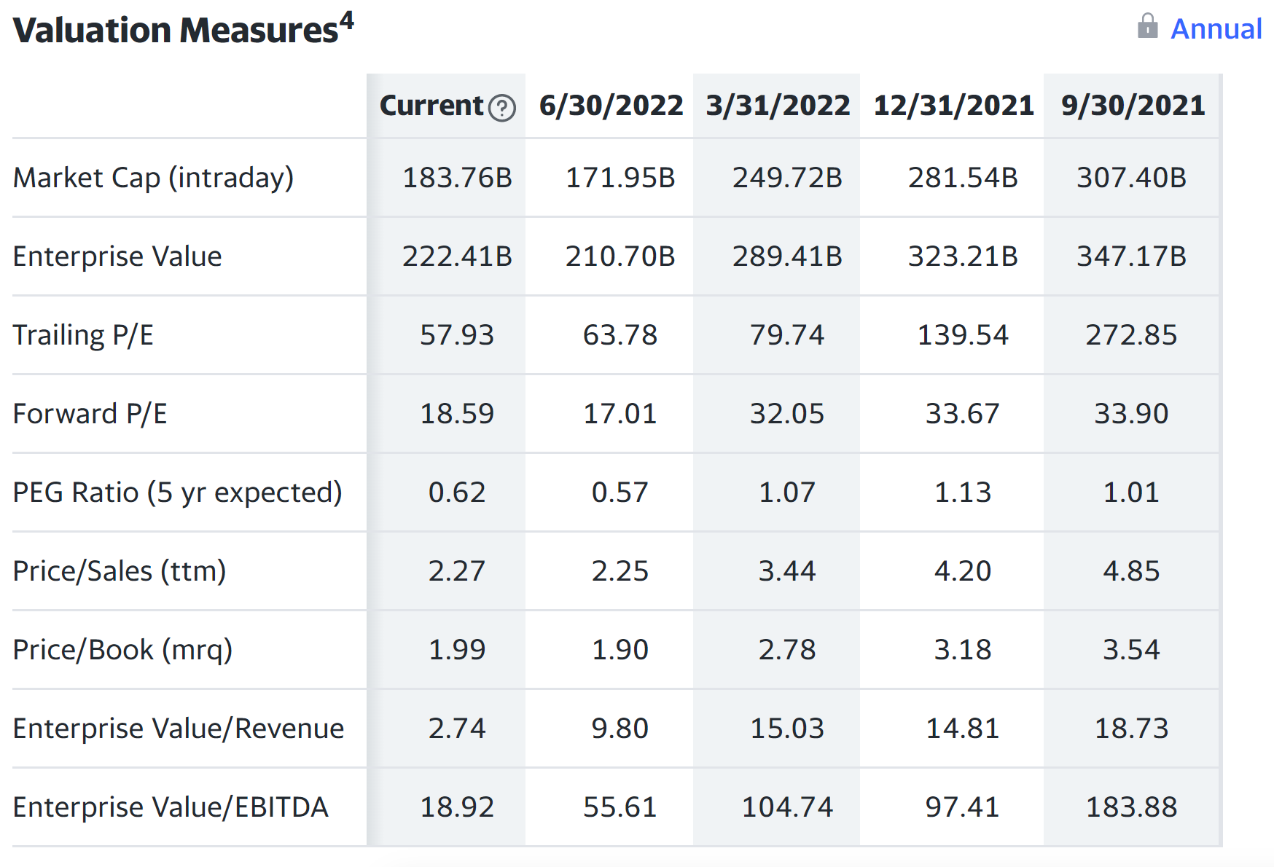
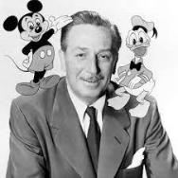
Introducing:
How analysts think about stocks?
10/7/2022
Does anyone know what these mean?

Slide 8
Turning Ideas into a Portfolio
  Student Stock Ideas
  Today, each student will present the stock they picked to the class.
  The best stock pitches have compelling reasons why the future will be bright for a company and its stock price.
  We will vote on which stocks to include in the Class Portfolio
  Four Stock Minimum
  Whether we include 1-2 additional stocks depends on votes
  We can always change our mind!
  Each month we can make trades after the class meets

Slide 9
Items to Consider
    What sector is each company in? (examples: consumer, financials)
                What is the market cap of the company (share price * all shares)
                What has the closing price been for the last 5 trading days for each stock.
                What is the 52 week high and low for this stock?
                Is the closing price closer to the high or the low for the year?
                Does the company make money?
                Is the company growing?
                Do you think this is a stable business or more volatile? Reasons?
                Are there recent news items that might be pushing the stock up or down?

Slide 10
Recap of Key Concepts
Stocks are partial ownership in the equity of a publicly traded company.
Historically and over longer time periods, stocks perform better than other places you can invest your money.
However, stocks carry risk and investors can lose money in an individual stock if the company struggles. Also the stock market can be volatile and there are periods of time when stock prices generally fall and investors lose money.
A company’s profitability is a key measure investors use to evaluate whether they should invest. Profit = Revenues – Expenses
Investors can find out more information about stocks on the internet, in newspapers, and other financial publications.

Slide 11
St. Constance Class Portfolio
These are the stocks that you selected last class – alongside the dollar amount invested into each company on Friday (Nov 17). The Weights column shows the percent of the portfolio that SC invested into each stock. We also updated the Market Capitalization and Price/Earnings multiples.
Remember: although Amazon won 56% of the weighted votes, the class felt as though it would be a good idea to balance out the portfolio so we would not have too much money riding on one stock. That’s usually a very good idea – and we will discuss the Importance of Diversification in our next class!

Slide 12
St. Constance Watch List
These are the stocks from Homework 1 & 2 that did NOT make the SC Class Portfolio.
We will keep track of these stocks all year! SC has the option to trade the portfolio every month.
Do you notice any differences between the Portfolio & Watch List stocks?

Slide 13
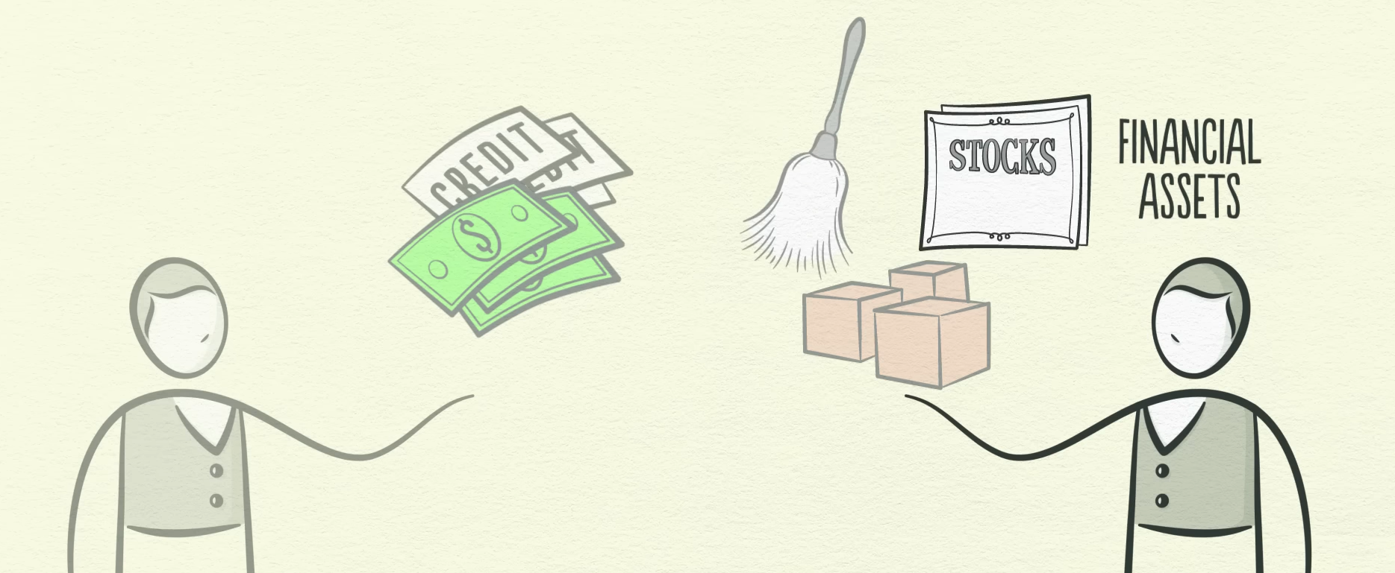
Homework #3
Before Next Class (December 5th)
Watch the Video Above: How the Economy Works by Ray Dalio
youtube.com/watch?v=PHe0bXAIuk0
Getting Ahead (January 15th)
Research Sectors with the Links & Resources Below

Slide 14
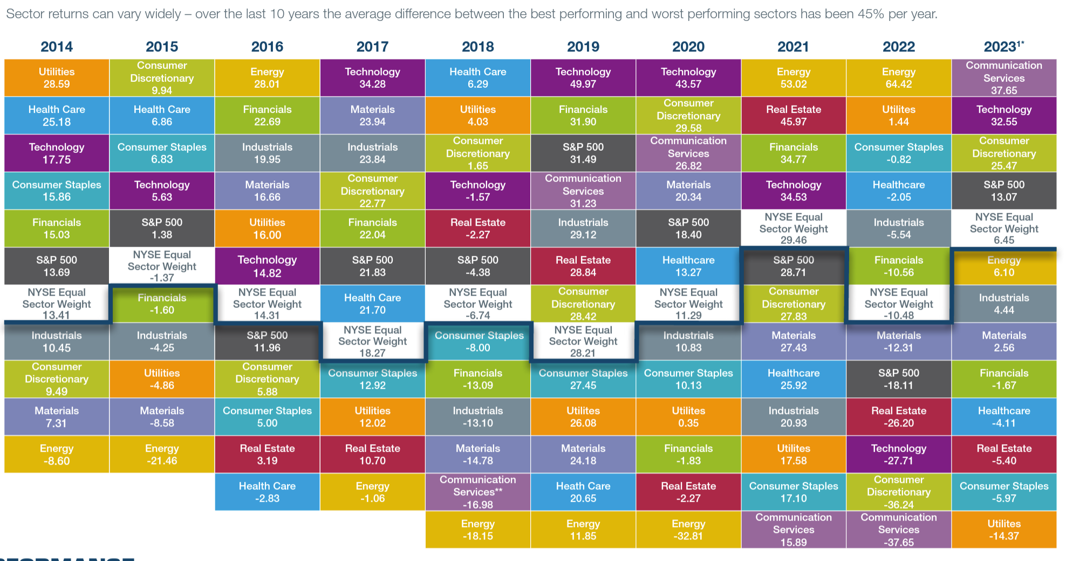
Individual Contest: Sector Funds
Which one of these will do the best between January and April?
Some swing from the top to the bottom. Others tend to stay in the middle.
Which ones do you think are the best for the contest? Portfolio?

Slide 15
Overview of Individual Competition
Sector Fund Edition!
You will be competing against your classmates only.
Each student will choose a different Sector Fund!
In January, each student will give a 1 – 2 minute presentation on:
Why they chose their Sector?
Why the Sector will grow the most this semester?
Which stocks (if any) from the Portfolio and Watch List are in that Sector?
                Students must hold their Sector from January through the end of the year.
                The students whose Sector has the largest percentage growth will win a prize. If many Students choose the same Winning Sector, those students will split the cash prize! You will have to decide if you want to choose a popular sector (split the prize) OR try to pick something nobody else will.

