Slide 1




Big Shoulders Fund | Stock Market Program
St. Constance Class of 2024
Class 5 – Stock Valuations
January 11, 2024
Damian
John

Slide 2
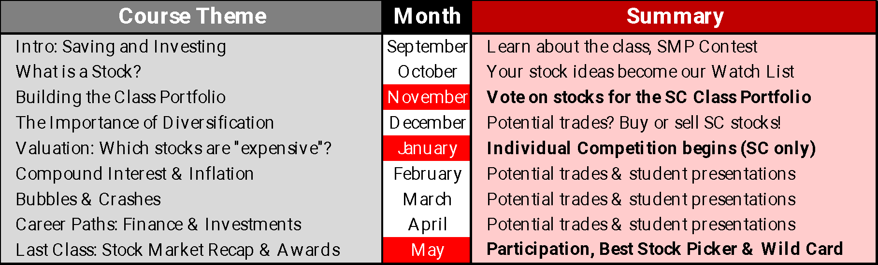
What will we cover in this class?
St. Constance:
January
  HW Review: Sector Funds
  Individual Contest
  Lesson: Valuations
* source

Slide 3
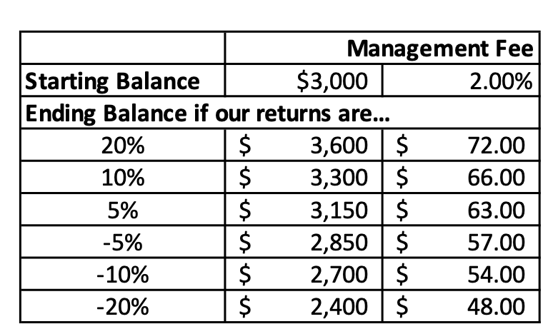
Class Portfolio: Contest Review
What (bonuses) are we playing for???
  All Big Shoulders Fund Stock Market Program participants (that means you!) will receive a management fee at the end of the school year.
    The fee will be calculated as 2% of our ending investment balance.
    We are starting the year with a $3,000 portfolio.
    What will your management fee be if our portfolio returns 10% by the end of the competition? How about if our return is -5%?
  The top 3 schools in the competition will also receive a cash contribution to their 8th grade class gift fund.
Who remembers the individual bonuses that are up for grabs?

Slide 4
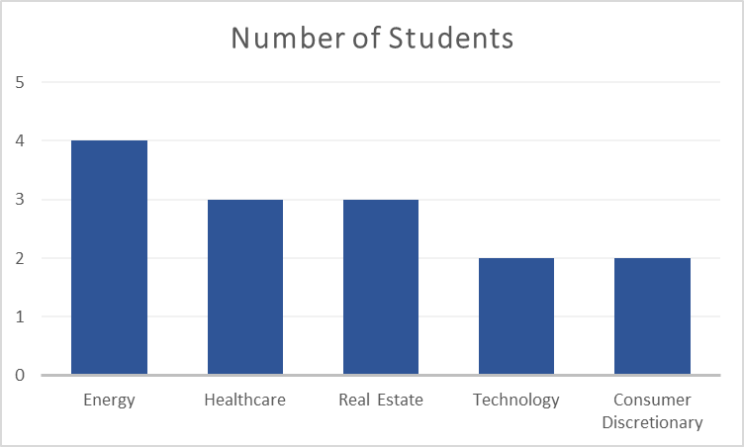
St. Constance
Individual Sector Contest
Prize Share: 25% 33% 33% 50% 50%
Since there is a fixed prize that will be split evenly…
If Energy is the best performer, each Energy student will get 25% of the prize
If Technology is the best performer, each Tech student will get 50% of the prize

Slide 5
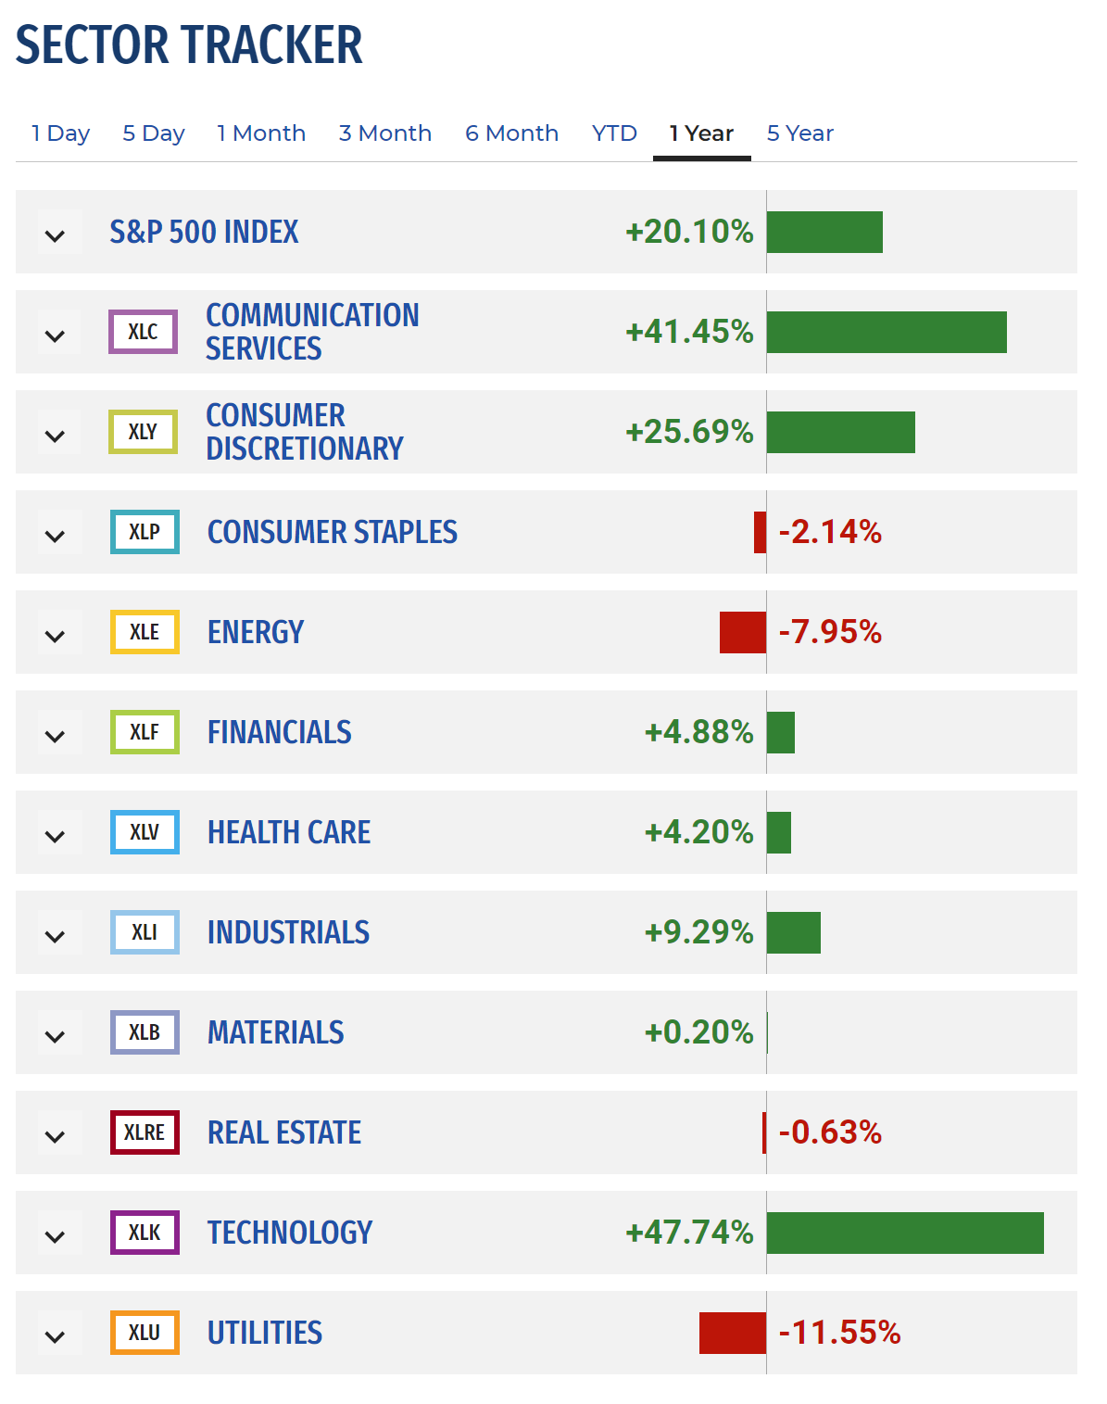
St. Constance
Individual Sector Contest
This chart shows how each sector has performed over the last year.
But don’t forget: past performance does not really tell us what is going to happen in the future!

Slide 6
St. Constance Class Portfolio
Trade Summary
December 7, 2023: Sell $100 AMZN, BUY $100 FSR
January = Apple, Adobe and Fisker will all be sold which will free up at least $1,000 to buy other stocks

Slide 7
St. Constance Watch List
January Class:
The groups decided to add:
Ulta, Target, Lockheed Martin and Lantheus off the Watch List

Slide 8
Class Portfolio: Updated Rankings

Slide 9
Recap of Key Concepts to Date
Stocks are partial ownership in the equity of a publicly traded company.
Historically over longer time periods, stocks perform better than other places you can invest your money.
Stocks carry risk and investors can lose money in an individual stock if the company struggles.
The stock market can be volatile and there are periods of time when stock prices generally fall and investors lose money.
A company’s profitability is a key measure investors use to evaluate whether they should invest.
  Profit = Revenues – Expenses.

Slide 10



Valuation – How to Compare Stocks

Slide 11

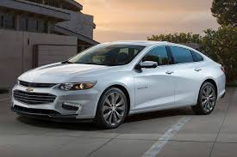
How Do You Compare
the Value of Two Items?
Which is a better purchase: a 1995 Chevy or a 2023 Chevy?
The 1995 Chevy will cost over $1,000 while a new Chevy costs about $29,000.
Is the extra money for the new car worth it?
Discuss some of the benefits a new car may have over the 1995 version.

Slide 12

How Do You Compare
the Value of Two Items?
$30,000
$35,000
Pictured above are two identical Tesla Model 3 cars.
They are brand new off the assembly line – but one costs $5,000 more.
Remember – they are identical. Which one would you rather buy?

Slide 13
How Do You Compare
the Value of Two Items?
A stock that is trading at $100 per share is not necessarily more ”expensive” than a stock that is trading at $10 per share.
It is easy to compare valuation of two items when they are exactly the same, but when there are differences, it is more difficult.
Just like our car example, a stock may be priced higher than a similar stock of a similar company, but you might be getting a lot more for your money.
Can you think of reasons why this might be the case?

Slide 14
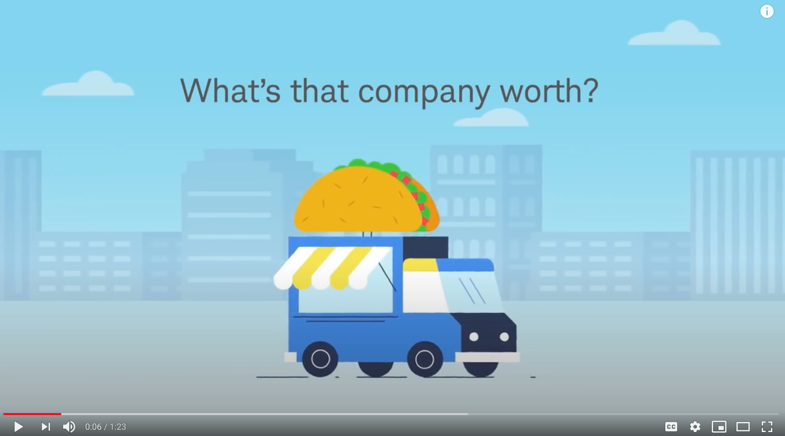
Price / Earnings Ratio
Please watch this video!
Click here for a short video explaining P/E

Slide 15

P/E Ratio
As a Measure of Valuation
What does it mean?
The P/E Ratio tells you how much investors are currently willing to pay for each dollar of a company’s current earnings.
Just like in the car example, we can look at how much earnings or profits we get for every share of stock we own. Then we compare it to other options to see if it is cheap or expensive.

Slide 16
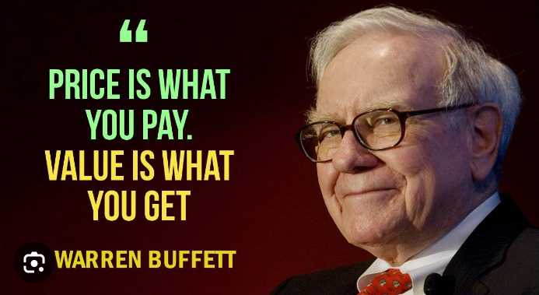
Comparison
Tesla, Inc (TSLA)
Market Cap: 744B
Price: $233.94
Earnings Per Share: 3.11
P/E Ratio: 75.2
Expected Growth Next Year: 20%
General Motors Company (GM)
Market Cap: 50B
Price: $36.31
Earnings Per Share: 7.12
P/E Ratio: 5.1
Expected Growth Next Year: 2%

Slide 17
Price/Earnings (P/E) Ratio
What does it mean when a stock has a high or low P/E?
A higher P/E Ratio may mean that investors believe that the company has very good growth prospects, and future earnings will be much higher than today, causing the stock price to continue to climb. But it may also mean that the stock is overvalued, or priced higher than future earnings may justify.
A lower P/E Ratio may mean that investors are skeptical about a company’s future earnings growth due to lack of demand for its product or higher costs expected in the future. But it may mean that the company is undervalued and is actually worth more than investors are currently willing to pay.

Slide 18
Price/Earnings (P/E) Ratio
Why would you be willing to pay more?
Higher growth rate stocks are typically more expensive, or have a higher P/E Ratio. This is because investors are often willing to pay more for a company that can grow faster, but there are also significant risks for paying too much for growth.
PE Ratio
Growth

Slide 19
Review – Key Concepts
When Should You Sell a Stock?
The Company Flounders
When an investor purchases a stock, they have certain expectations for what the future might hold. When something changes and the company loses its way, it is time to take a closer look.
The Stock is Overvalued
The stock market sometimes becomes over-enthusiastic about a company’s prospects and pushes valuations past reasonable levels. The risk of the stock price going down (downside risk).
The Holding Becomes Too Big
A well diversified portfolio shouldn’t have too large of a weighting in one stock. If the holding becomes too large due to price appreciation, it may be time to trim to reduce the weight.
A Better Idea is available (SC WatchList)!!

Slide 20
Small Group Decisions & Homework
Reminder
HW Due February 10th
For the rest of the school year, your Small Group will decide what to do with $750!
SC Class Portfolio
Each group must choose 1 or 2 stocks.
More details on the following page!
In February, we will trade the Class Portfolio based on what each of the 4 groups decide to do with their $750.

Slide 21
HW: Video & Class Portfolio Trades
In our last class, the four groups selected 7 stocks for the portfolio – but we can only hold 6!
Uber Ulta Amazon Target Lanthus Prologis Lockheed Martin
We need to get rid of one stock idea. The quick Homework will be – please let us know, as soon as possible, which stock you think should NOT be in the St. Constance Class portfolio. The sooner we have your feedback the sooner we can trade the portfolio.

