Slide 1

Big Shoulders Fund | Stock Market Program
St. Constance Class of 2024
Class 7 – Market Cycles: Bubbles & Crashes
March 14, 2024
Damian
John

Slide 2

What will we cover in this class?
St. Constance:
March
Lesson: Bubbles & Crashes
HW Review
Envelope Game
Still time to win one of these!
* source

Slide 3
St. Constance – NEW Portfolio
Reminder: On February 12th we sold Microsoft, Apple, Adobe and Fisker.
Those proceeds were used to buy Prologis, Target, Ulta and Lantheus.

Slide 4
Big Shoulders Universe

Slide 5
Sector Fund Competition
Reminder: there are no switches in the Individual Contest -
These are your Sectors for the rest of the year.

Slide 6
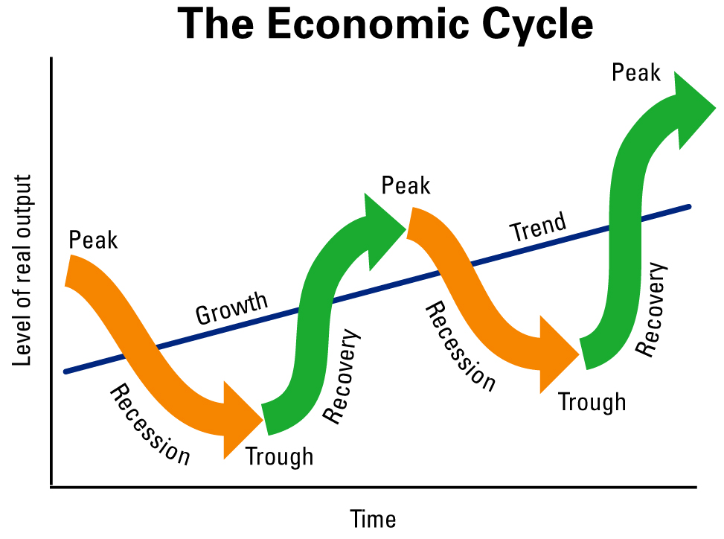
Economic Cycles
Who remembers Ray Dalio – and the Economic Machine?

Slide 7
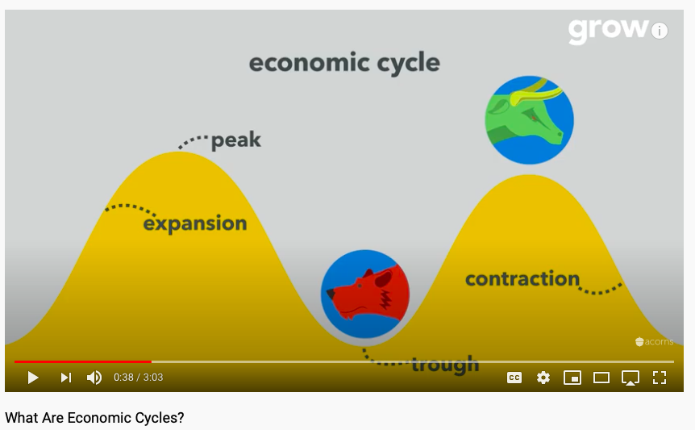
What Are Economic Cycles?
Please watch this video!
https://www.youtube.com/watch?v=zgDVI9z3Djw

Slide 8
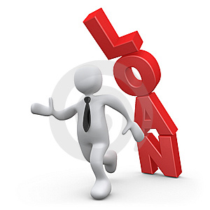


Why Do Economic Cycles Exist?
“Extra Credit” = Participation Edge
Review slides #19 – 31, think about these concepts critically and develop 1 Great Question that you can ask in class
In good times people (and businesses) tend to:
1. Overborrow
2. Overproduce
3. Overexcite about new technologies

Slide 9
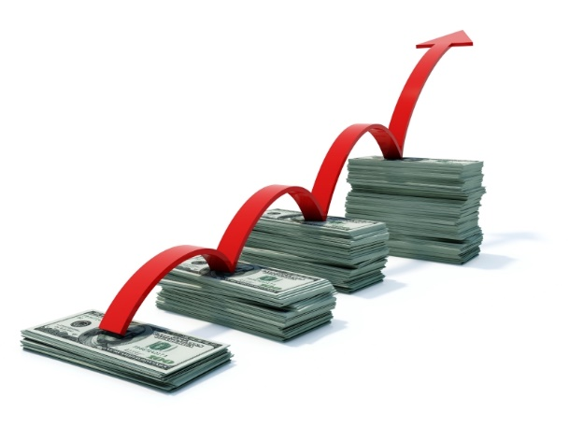

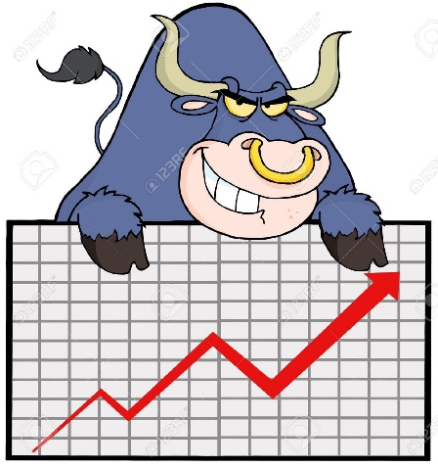
Overborrowing
When the economy is strong:
1. Incomes grow
2. Asset prices go up
3. Stock market booms
People sometimes overestimate their ability to pay back a loan in good times, and they borrow more than they can afford to repay.

Slide 10



Overproduction
In good times, businesses add production capacity, and sometimes the supply of goods outpaces the demand:
Real estate
Cars
Durable goods

Slide 11


New Technologies
Sometimes new innovations inspire a lot of optimism, which pushes stock prices up:

Slide 12
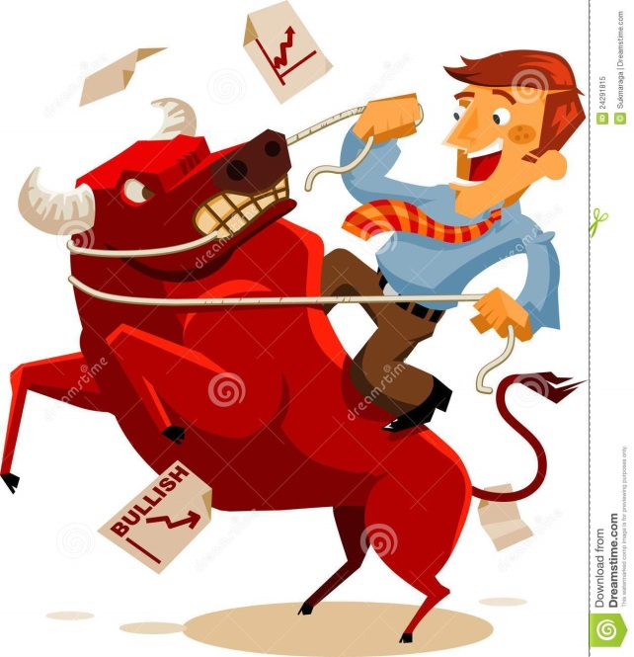
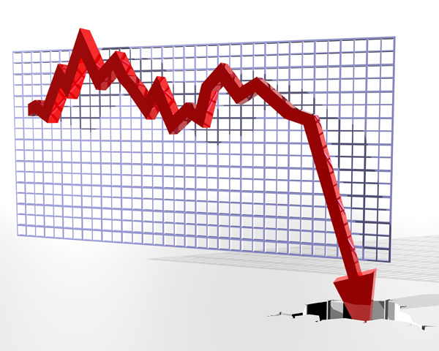
Economic Slowdown and Market Decline
When expectations outpace reality, the ”bubble” often bursts, and everyone tries to sell at the same time. Slowdowns in the economic cycle can lead to job losses and recessions.

Slide 13
There Have Been Many Instances
of Investment Bubbles in the Past.
Here are some examples!

Slide 14

Tulip Mania of 1634-1637 in Netherlands
The Tulip was introduced in Europe in the 17th century, and quickly became a symbol of success.
Tulip prices went up dramatically, and sophisticated markets developed around trading tulips.
Some tulip bulbs sold for more than 10 times the annual income of a skilled craftsman.

Slide 15
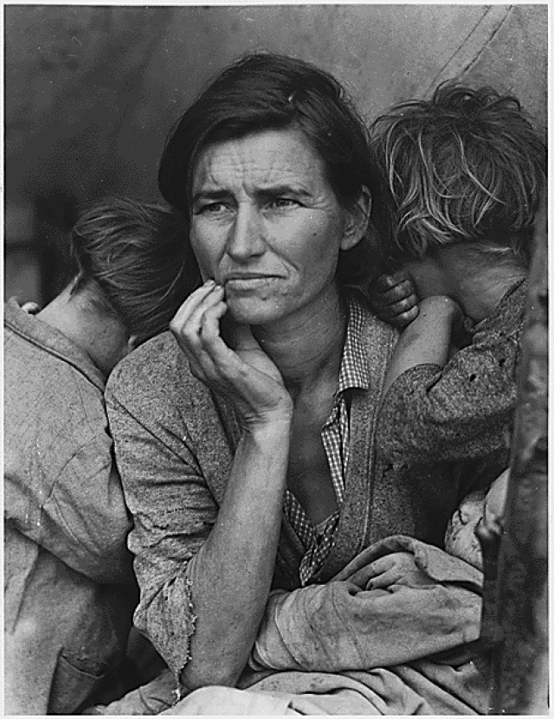
The Great Depression of 1929-1932
Economists still argue about the causes.
Unemployment reached 25% in the US, and up to 33% in other countries.
Economic uncertainty from the
Depression helped contribute to the start of World War II.

Slide 16

The Dot-com bubble of 2001
Fueled by the revolutionary implications of the internet and telecommunications technology.
However, many companies did not have real business models, and 50% of dot-coms did not survive the burst.
$5 trillion in market value of technology companies was wiped out between 2000 and 2002.

Slide 17
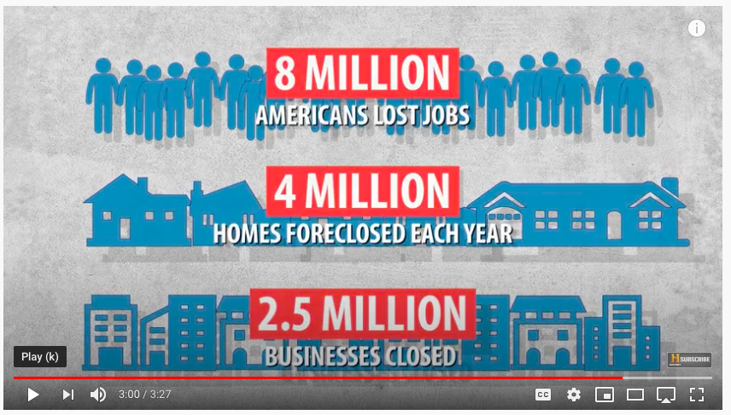
The Great Recession
Please watch this video!
https://www.youtube.com/watch?v=yM0uonkloXY

Slide 18
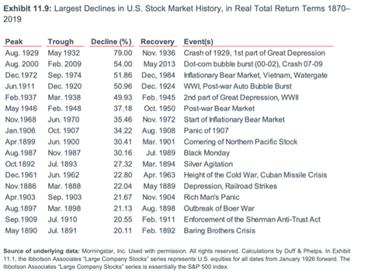
Economic Downturns
Throughout History

Slide 19
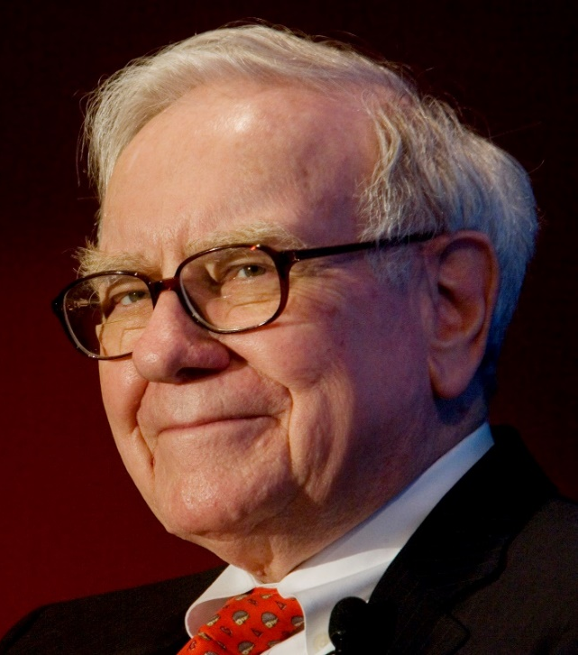
Crashes Can Be a Great Buying Opportunity for a Disciplined Investor
Warren Buffet is one of the most successful investors of all time.
He built his fortune from $10,000 in 1950 to $87 billion in 2018, partially by buying shares of good businesses in bad times, and holding on those shares over the longer term to benefit from compounding.

Slide 20
Homework & Class Activity
Homework #1: Class Feedback on the Stock Market Program (SMP) Due Date: April 5
How would you rate your SMP experience overall (1-10)?
What is your favorite part (class topic, activity, competition, or anything else) of SMP?
What is your least favorite part of SMP?
If you could make one change to enhance the SMP experience, what would it be?
Do you like Group Work? Is that a better way to build the portfolio? Do Homework?
Did you like the WatchList? Why or why not?
What advice would you give to the next 8th grade class?
What feedback would you give your SMP teachers (Austin, Damian and/or John)?
Are you interested in learning more about finance and investing? Any specifics?
Do you think you might want to pursue a career in finance? Generally, or specific ideas?
11) Anything else?!
Homework #2: Watch these videos and then discuss your stocks with your group!
  https://www.youtube.com/watch?v=zgDVI9z3Djw https://www.youtube.com/watch?v=yM0uonkloXY Due Date: April 5
Homework #3: Solve The Envelope Game – Details on the Next Page Due Date: April 5

Slide 21


Homework: Solving the Envelope Game
Next class, each member of the Group with the most thoughtful overall response to HW #1 will have the opportunity (but not the obligation) to play the Envelope Game.
We value your direct feedback and want to improve the class – so please be honest!
If you Choose to play, you will simply select 1 of 5 envelopes. No switches!
Homework #3: How much is the Envelope Game worth?
There is an exact answer so… Group work encouraged for HW#3!
Written Response due in Class (April 19) but you can submit to Ms. Blecka earlier.
Each envelope will have one of the following outcomes inside. Look back through class notes and find the formula that helps you determine how to solve the math problem below.
As we discussed in class, this framework (and formula) can be used to help you make tough decisions for the rest of your life!
There will be one envelope with each of the following outcomes:
        Zero = Nothing won or lost
        Win $5
        Win $10
        Win $20
        Lose $10

Slide 22
Pop Quiz
Who thinks they know which 3 stocks have been the very performers since our Watch List was originally built back in October?

Slide 23
Looking Back: The Original Watch List

