Slide 1

Big Shoulders Fund | Stock Market Program
St. Constance Class of 2024
Class 8 – Career Paths
April 18, 2024
Damian
John
+ Special Guest

Slide 2

What will we cover in this class?
St. Constance:
April
Lesson: Career Paths
Individual Contest
* source

Slide 3
St. Constance Portfolio

Slide 5
Sector Fund Contest Stock Contest
The Energy Sector has jumped out to a big lead – but anything can happen in the last month!

Slide 6
St. Constance Watch List: Looking Back
Takeaways: Incredible job of building a Watch List and Class Portfolio!
Midyear Trades hurt the portfolio – and so did performance chasing.
Burning Question: Who was missing the day we made midyear trades…?

Slide 7
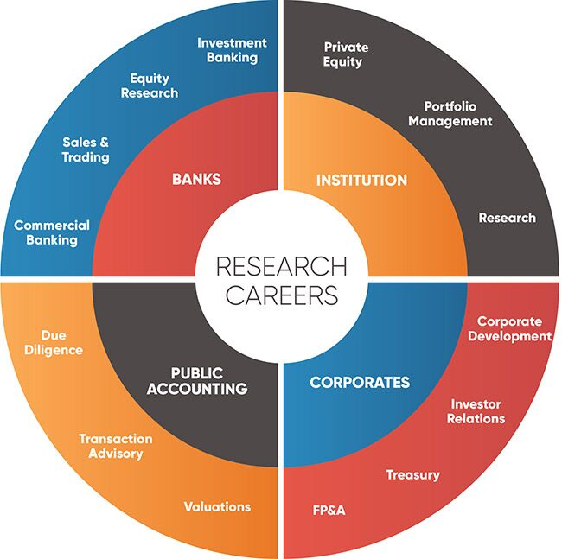
Career Paths In Finance & Investing?

Slide 8
Institutional Investment Process
Build a Watch List of Investment Ideas
Evaluate Ideas
Trade
Market Research
Performance Reporting

Slide 9
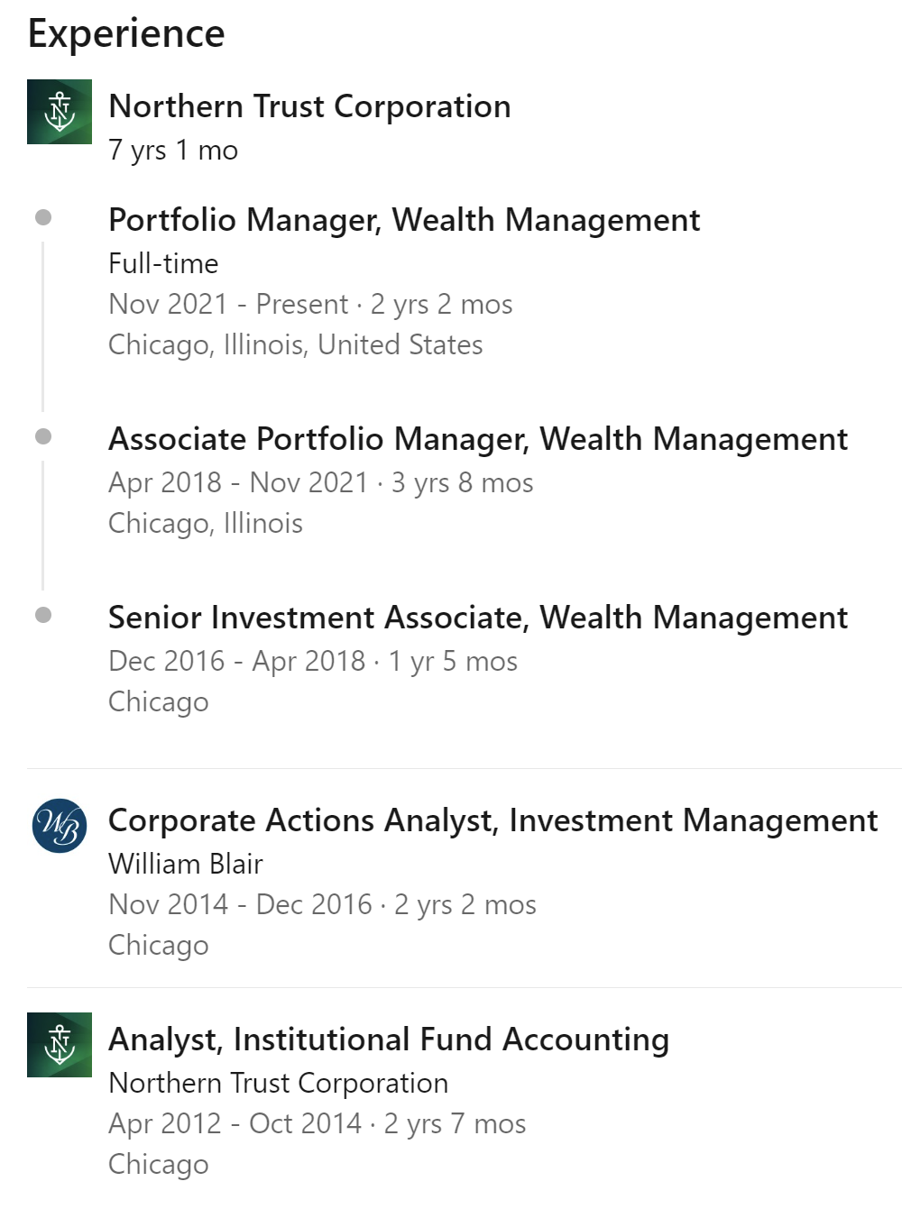
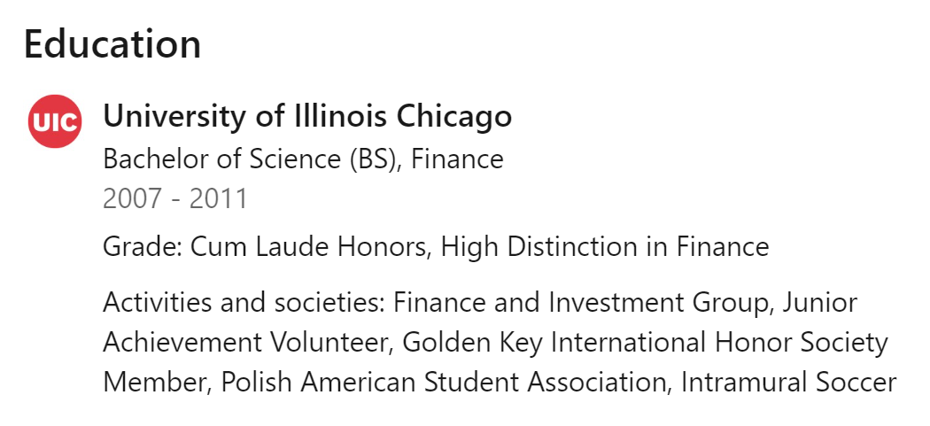

Guess Who?

Slide 10
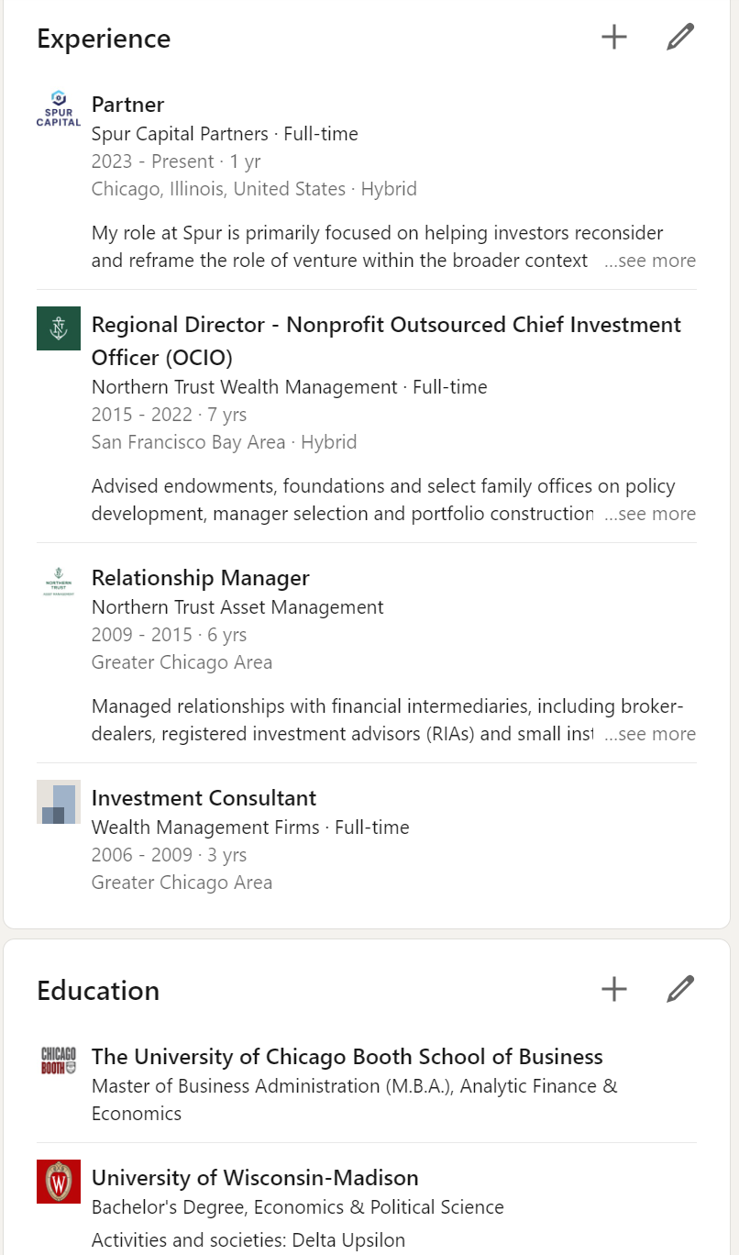


Guess Who?

Slide 11
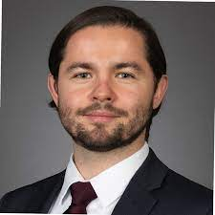
Wealth Management
Works with individuals and families to invest assets to fund retirement, philanthropic interests, and inheritances for children and grandchildren.
Skills required: Communication, presentation, math/statistics and understanding of financial markets

Slide 12
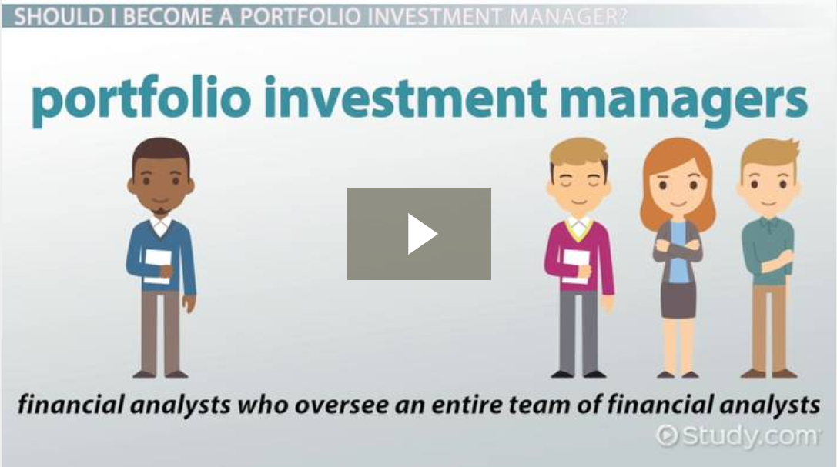
Portfolio Manager
Makes investment decisions using money clients have placed under his or her control.
Can also be a person who manages a financial institution's asset and liability (loan and deposit) portfolios.
Portfolios can consist of all stocks, all bonds, real estate, or a combination of a bunch of different types of securities.

Slide 13
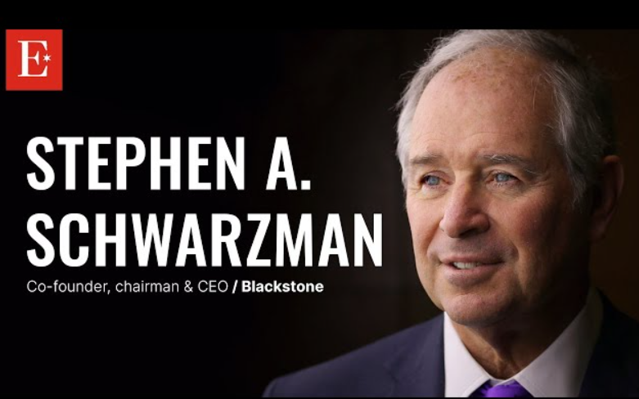
Private Investors
Invests in stock of small companies, help them grow.
Invest in entrepreneurs and help them build brand new businesses that disrupt the big old companies.
Number of Jobs in America: 100,000 +
Skills: Ability to analyze the value and potential growth of a company.
2024 Net worth: $37.8 billion
13

Slide 14
Types of Investment Firms
Buy Side | Sell Side
Called “buy-side” because the firm buys securities for the benefit of its clients | Called “sell-side” because the firm provides research and analysis as a product which facilitates the sale of securities
Clients can be large institutions, individuals, and everything in between | Clients are the buy-side firms
Goal is to outperform a benchmark or meet a specific investment objective for client | Often rate securities buy, sell, or hold; publishes earnings estimates which form “consensus”.

Slide 15

Trends in Finance
Expected employment growth.
  - Personal Finance Advisors expected to grow 32%
  - FinTech opportunities expected to grow 25%
  - Financial Analysts expected to grow 23%
  - Bill and Account Collectors expected to grow 14%
  Book Keeping, Accounting, and Auditing Clerks expected to grow 15%
Clients are better educated in finance.
On-line financing and investing is changing the field quickly.
Competition for entry-level jobs will be strong.

Slide 16

What Can I Do Now?
Join your high school’s investment club. If one doesn’t exist, START one.
Look for summer programs that work with kids in investments and/or statistics. Some may be offered at camps, or colleges in the Chicago area.
Try to find a job or internship working with a financial advisor or at an investment firm. You will soak up knowledge even if your day-to-day responsibilities don’t seem that fun.
Stay in contact with Big Shoulders Fund and your volunteer teachers.
Learn Excel! YouTube videos can teach you how to do your math homework with Excel.
It is an incredibly powerful tool!

Slide 17



Final Homework: Due May 6th
Use an AI Application to do something cool:
Draw a picture, write a joke/song, evaluate a stock idea, build a logo for a company you want to start…or an existing business that you think should have a better logo!
You can get help from you family, use any application and build whatever you want - the best HW will get to play a game!
Optional: Is there anything we didn’t talk about in this class that you wanted to learn about?

